Slide 1
Corporate Responsibility Communication Cascade
November 2010

Slide 2
Corporate Responsibility Communication Cascade
This cascade is intended to…
Remind employees to complete all compliance training and to highlight new policy language regarding the enforcement of training completion
Introduce a new compliance tool that is now available at Geospatial Systems locations*
*Not in Dayton, Ohio or San Diego, California sites

Slide 3
Corporate Responsibility
at GS is:
A combined network of resources available to help guide Geospatial Systems employees’ adherence to ethics and compliance rules
An organization that includes the ethics, security and trade compliance departments.

Slide 4
Compliance Training
Part of CR’s responsibility to provide guidance about ethics and compliance involves annual compliance training. Education is not just a key component of Corporate Responsibility, but it is each employee’s personal responsibility.
A new policy has been developed to help ensure that all ITT employees understand their obligation to complete assigned mandatory training. It involves set progressive disciplinary deadlines aimed at preventing delinquent compliance training completion in the future.

Slide 5
Current List of Mandatory Training:
Course | Target Audience | Length | Launch Date
Rolled Out / In Progress
Information Security | All employees with computer access | 1 hr | 06/04/10
U.S. Export Controls | ALL EMPLOYEES | 1 hr, 39 min | 08/20/10
Truth in Negotiations Act (TINA) | All Contracts, Program Management and Corporate Responsibility employees. Select employees from: HR, Business Development, Finance, Engineering, QA, P&IC, Purchasing and Operations | 1 hr | 09/21/10
Procurement Integrity | All Contracts, Program Management and Corporate Responsibility employees. Select employees from: HR, Business Development, Finance, Engineering, QA, P&IC, Purchasing and Operations | 1 hr | 10/05/10
Organizational Conflict of Interest (OCI) | All Contracts, Program Management and Corporate Responsibility employees. Select employees from: HR, Business Development, Finance, Engineering and Operations | 18 min | 10/20/10
Upcoming
Annual Security Refresher Briefing | ALL EMPLOYEES | 20 minutes | 11/08/10
Foreign Corrupt Practices Act (FCPA) II | All International Business Development, Sales & Marketing, Management and Finance employees | 30 minutes | 11/03/10

Slide 6
Compliance Training
Employees have been assigned some or all of these training courses based on the employee’s specific duties and responsibilities within ITT.
The specific training courses assigned to you are listed on your GS Training & Events Management System (TEMS) page.
Any of the training courses listed on the previous slide that are also listed on your TEMS page are considered to be mandatory and must be completed by the due date listed in TEMS (or as indicated by your supervisor, if you are a non-wired employee).
See slide 8 for a screen shot of TEMS training requirements.

Slide 7
Compliance Training
Strict adherence to the training completion dates is required. FAILURE TO COMPLETE THE MANDATORY TRAINING SPECIFIED FOR YOU WILL RESULT IN THE FOLLOWING ACTIONS:
1: Verbal warning
2: Written warning
3: Appropriate administrative action to include suspension
You are not required to take any training that is not listed on your TEMS page.

Slide 8
TEMS: How Do I Tell If I Have Assigned Training To Complete?

Slide 9
Compliance Training
Per the new policy, the final deadline to complete all assigned compliance training for this year is DECEMBER 31, 2010.
After this date, any employee who has failed to complete this mandatory training will face disciplinary action.

Slide 10
Compliance Training
If you are having a problem accessing TEMS, please contact Matt Price (585-269-7082) for assistance.
If you are a non-wired employee (and do not have TEMS) or have questions related to training course selection, please contact Lynn Sperger (540-561-0325).

Slide 11
The CR Connection
Introducing a new compliance tool:

Slide 12
Concerns or Input Can Be Provided to Many People and in Many Ways
ü
Your Supervisor
ü
Compliance Manager
ü
Any Supervisor
ü
Deputy Compliance Mgr
ü
Member of HR Dept
ü
Controller/Finance
ü
General Counsel
ü
EthicsPoint
CR Connection
NEW!
ü
Ombudsperson
ü

Slide 13
What is the CR Connection?
CR Connection boxes will be located in common areas throughout GS facilities, along with detachable comment forms on which you may write and submit a question, comment or concern.
Identifying information, such as name, ID number or supervisor, is optional. This tool can be 100% anonymous if you wish it to be.
The Connection boxes will be checked on a biweekly basis by a member of your site CR leadership team.
This is an easy way to submit feedback, ask questions or report issues or concerns in a way that will result in action and answers.

Slide 14
Why the CR Connection?
For those who do not have convenient access to a computer or telephone at work, we are introducing the CR Connection.
In addition to EthicsPoint (ethicspoint.com/ 1-866-294-8691), the CR Connection offers another anonymous reporting avenue.

Slide 15
Locations:
Site (number of boxes) | CR Connection Box Locations
Herndon (1) | 3rd floor lunch room
Roanoke (4) | Break rooms in Buildings 1, 2, 3 and 5
West Springfield (3) | Hallways as follows… 3rd floor – across from elevator by HR bulletin board 2nd floor – across from the cafeteria entrance by HR board 1st floor – bottom of stairwell near south entrance
Bloomfield (3) | Break/coffee rooms
Clifton (1) | GS mail drop office G39-4
Ft. Wayne (3) | Cafeteria at TAC In break room at West Cook Tech Center In ALPHA office area at Summit
Rochester (4) | Cafeteria located at self-care centers
Boulder (1) | 1st floor lunchroom by water cooler

Slide 16
Look for the Box With This Graphic:

Slide 17
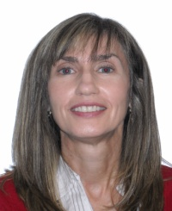
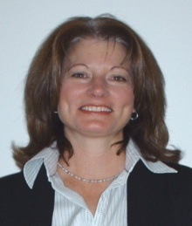
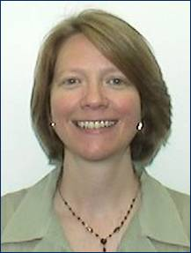
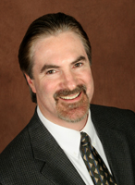
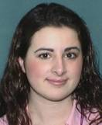
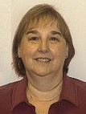
For additional questions, please contact your site lead listed below who will responsible for checking the CR Connection boxes in your location.
Questions?
Rhonda Kennedy
Site Lead
(Bloomfield & Clifton)
Shalin Kastler
Site Lead
(Boulder)
Kili Mesner
Site Lead
(Roanoke)
James Barry
Site Lead
(Rochester)
Monica Senk
Site Lead
(Ft. Wayne)
Rachel Kingston
Site Lead
(West Springfield)
Marcia Fairman
Site Lead
(Herndon)

