Slide 1
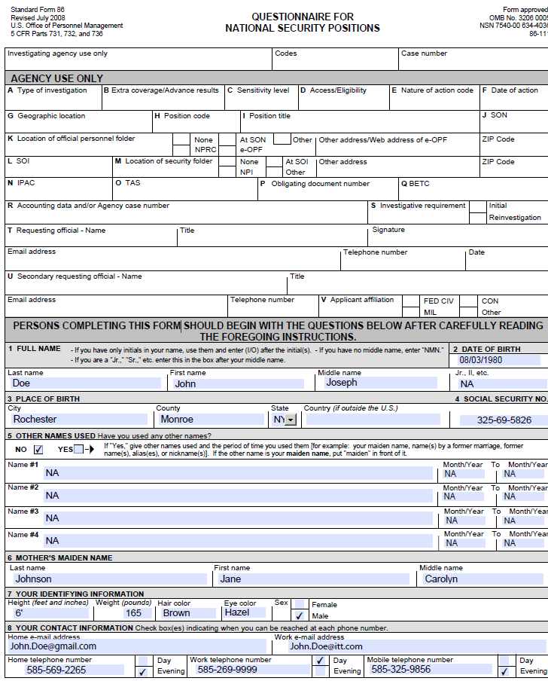
Page 1 Assistance:
To enter your SSN and have it put in the bottom corner of every page do the following:
Enter number without any dashes and hit enter. This should put dashes in automatically and put in on the bottom of every page.

Slide 2
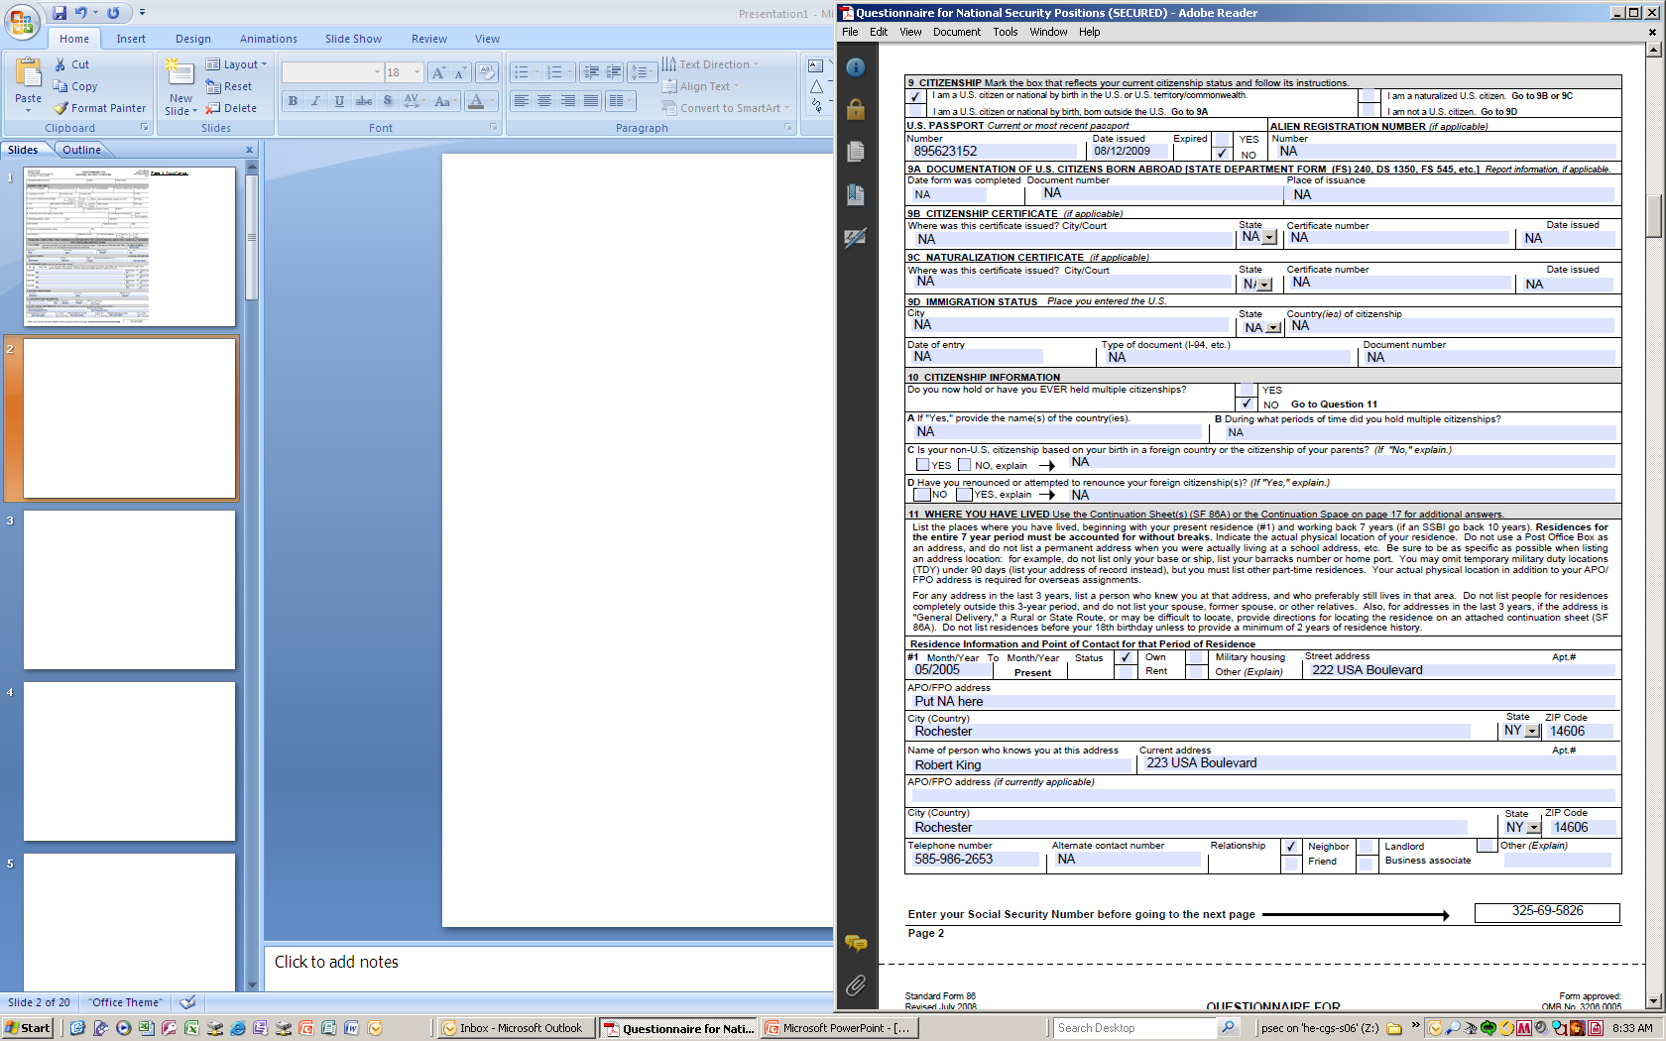
Often people forget to answer Question #9…simply check mark the appropriate box and go from there.
Even though the instructions here say to go back 7 or 10 years…do the following:
For 5-Year Updates only go back 5 years.
For initials go back 10 years.
Don’t forget to include someone who knows you with correct contact information (you cannot list a PO Box).

Slide 3
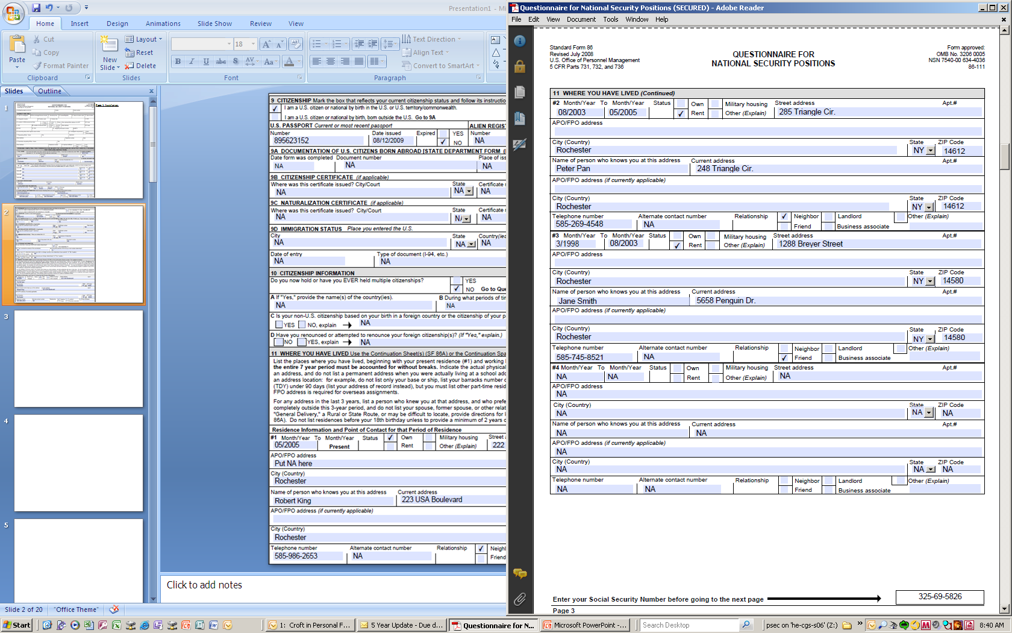
Be sure that your dates add up from all your previous addresses…people frequently make errors here.
For any address from PRES to 3 years ago you will need a "Person who knows you"
- You cannot use a Family Member

Slide 4
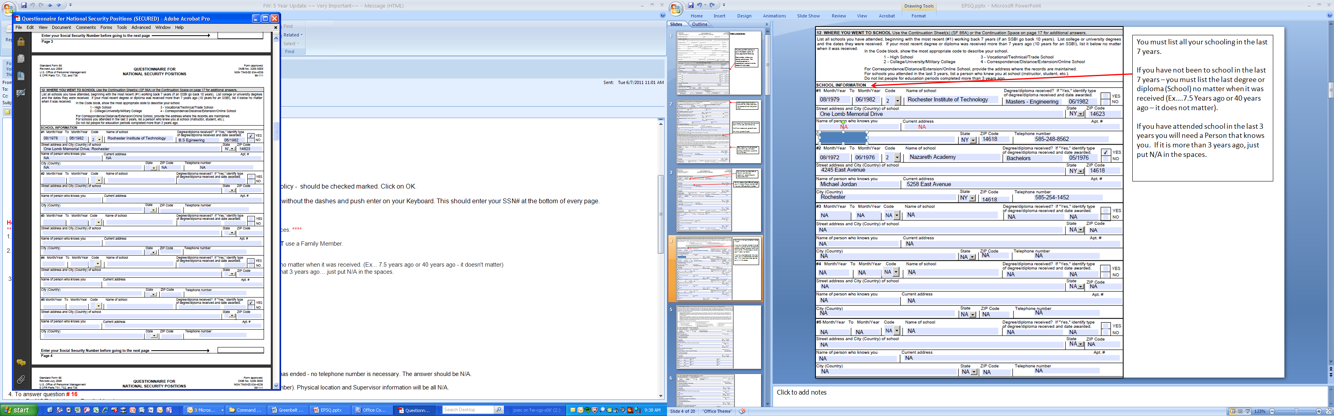
You must list all your schooling in the last 7 years.
If you have not been to school in the last 7 years – you must list the last degree or diploma (School) no matter when it was received (Ex….7.5 Years ago or 40 years ago – it does not matter).
If you have attended school in the last 3 years you will need a Person that knows you. If it is more than 3 years ago, just put N/A in the spaces.

Slide 5
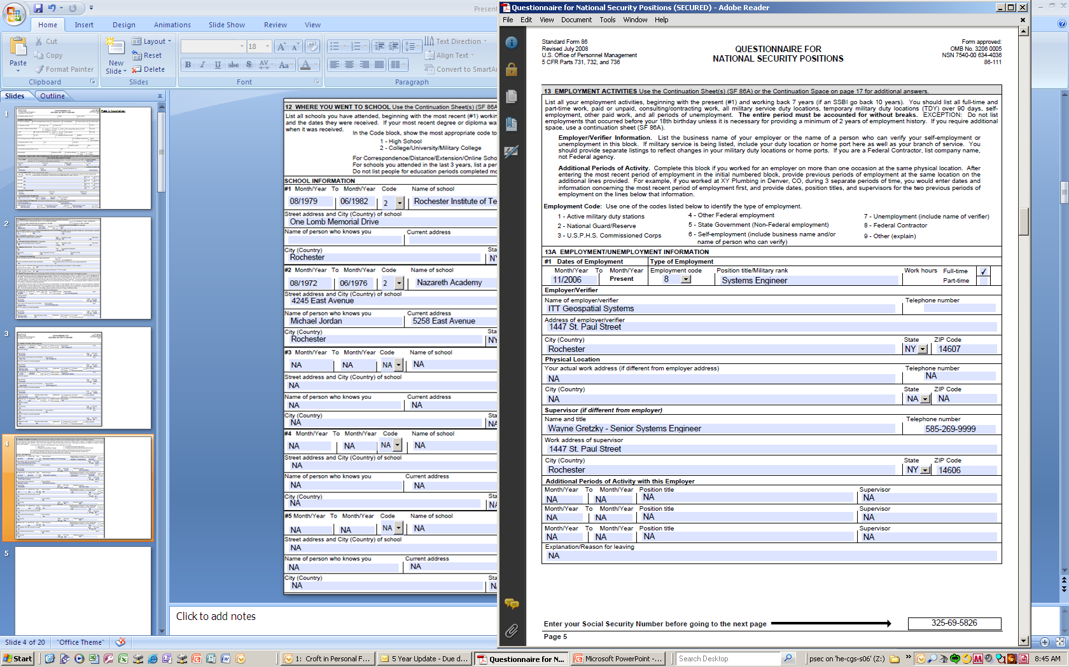
ITT Employees and new hires should list ITT as their first entry:
Employer Name: ITT Geospatial Systems
Employer Address: 1447 St. Paul Street, Rochester, NY 14606
Employer Telephone Number: 585-269-5000
The physical location is you actual location and telephone number.
The supervisor is his/her actual location and telephone number.
Other things to remember:
Remember to include your Position, Title, and
Employment Code (8)
Must have a supervisor and telephone # for all
employers listed.
For unemployment – must have verifier –
address and telephone number (can be a
family member). Put N/A for Physical location
and supervisor information.
14606

Slide 6
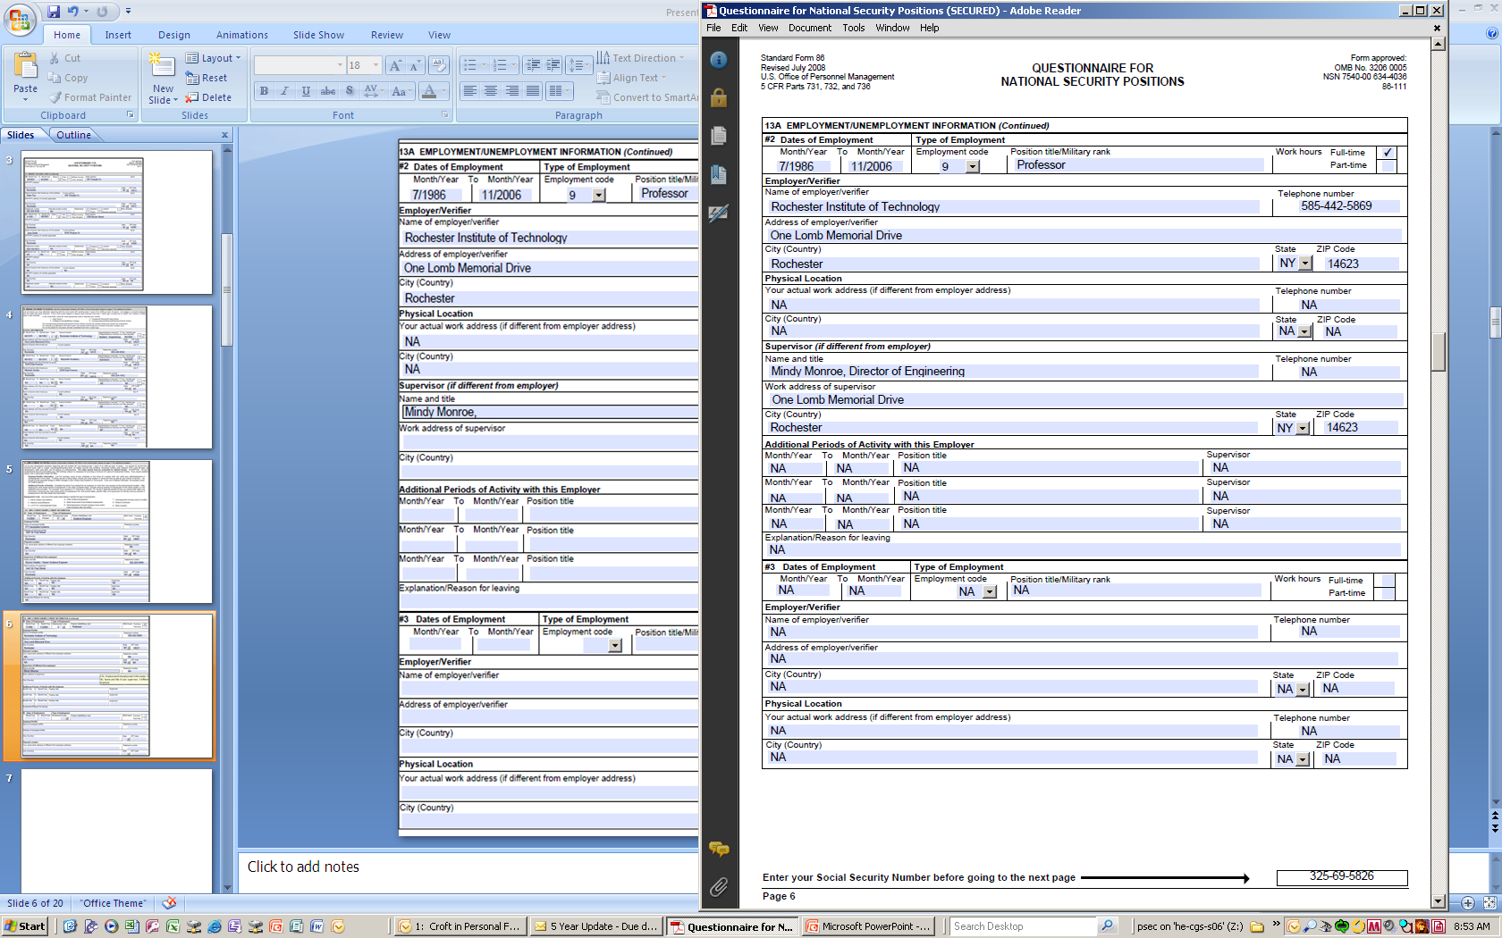

Slide 7
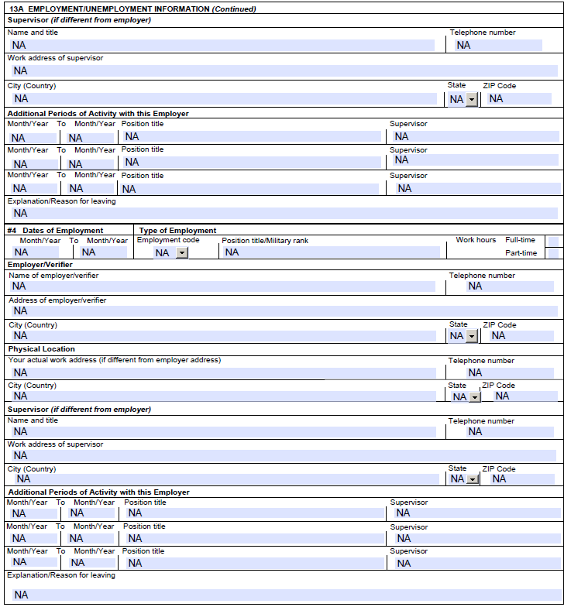

Slide 8
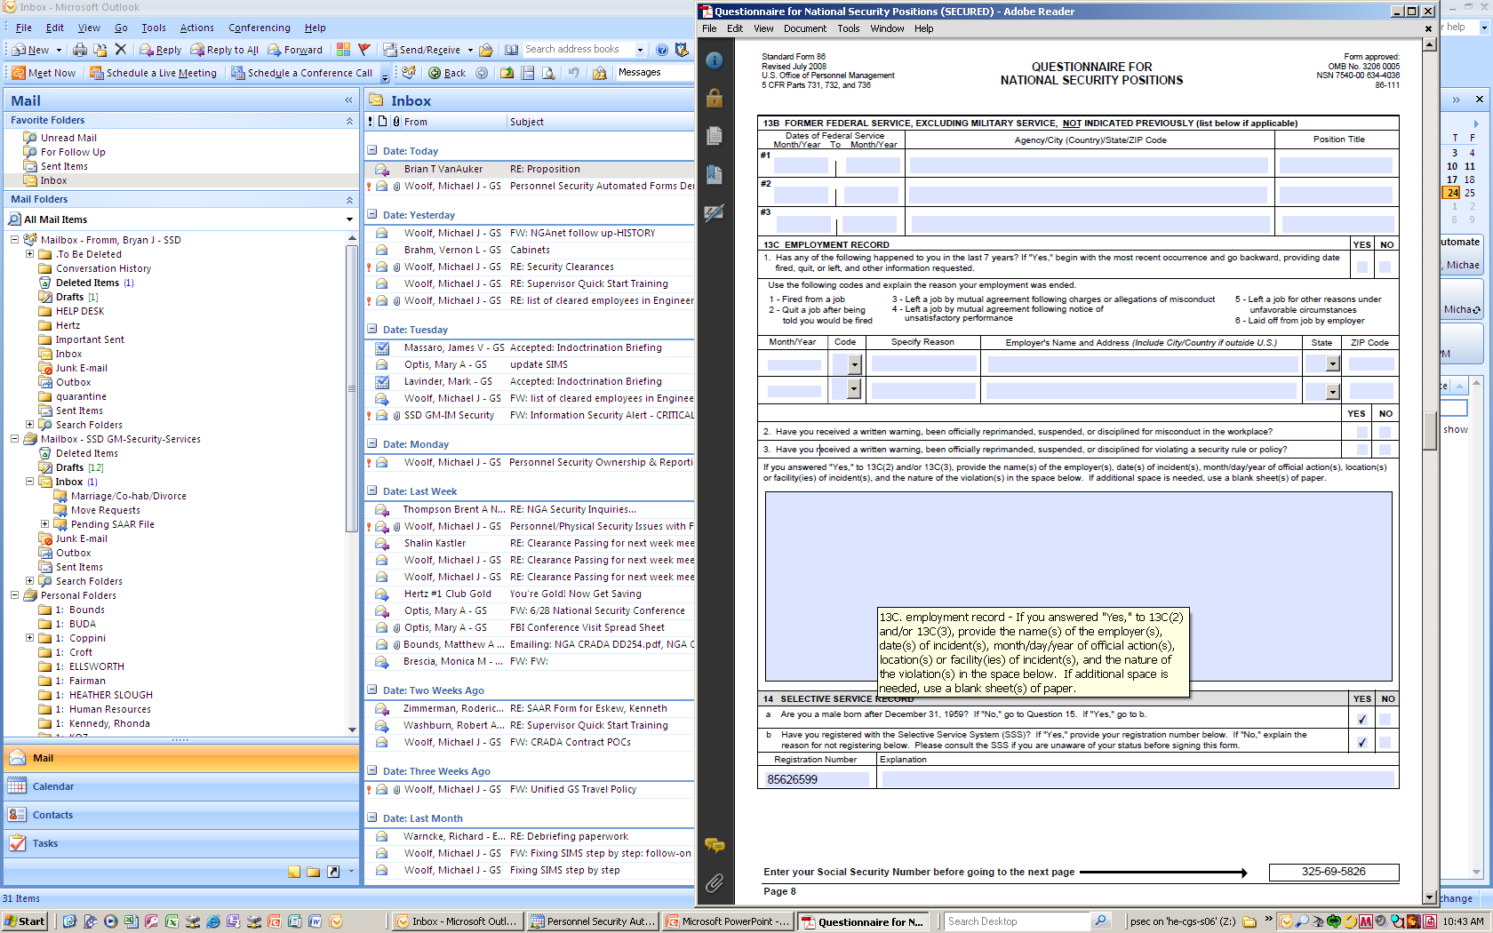
13B: Be sure to list any applicable information. If you have not had former federal service please be sure to put “NA” in all areas.
13C: Answer all questions truthfully and honestly and if items are not relevant to you please notate by filling in with “NA”.
If you cannot locate your Selective Service # the following website will assist you:
https://www.sss.gov/RegVer/wfVerification.aspx

Slide 9
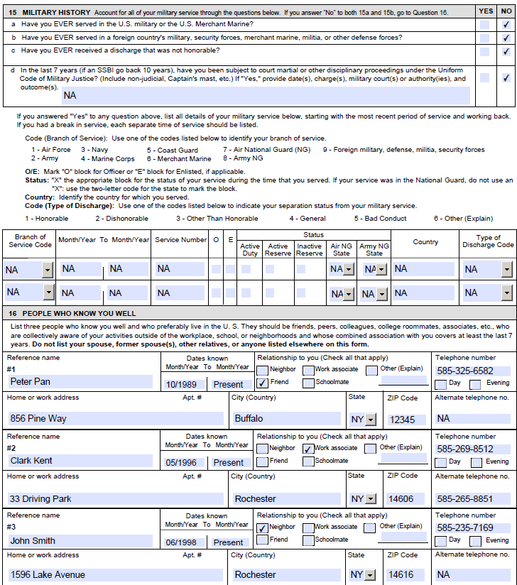
Question 16:
Do not include any family members
Dates knows should be when you met
them to PRES. (ex. 01/2001 – PRES.)
Each reference must have full current
address (no PO box) and phone number.

Slide 10
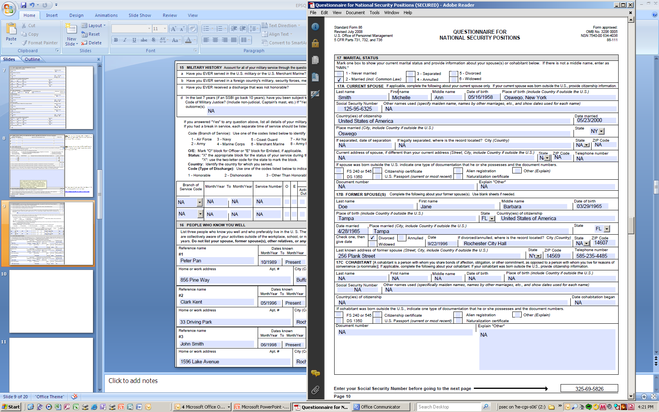
Question 17:
Other names used for spouse – remember to include maiden name.

Slide 11
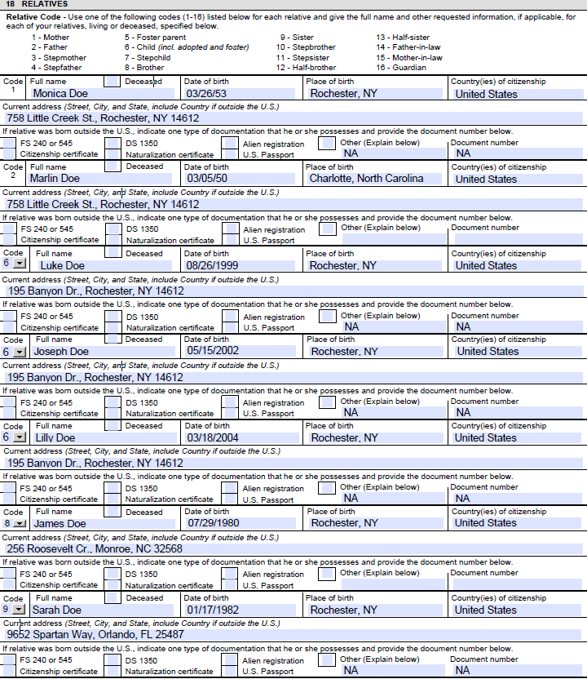
Question 18:
Remember to include all the relatives 1 through 16 that pertain to you.
Be sure Place of Birth has CITY and STATE; this is a frequent error.
If you need more space for relatives go back to SharePoint page and click on “Supplemental Relatives Page”.

Slide 12
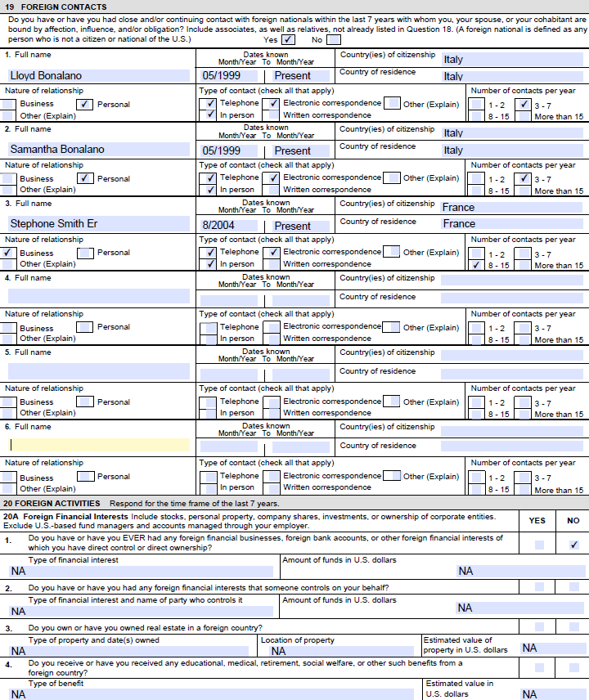

Slide 13
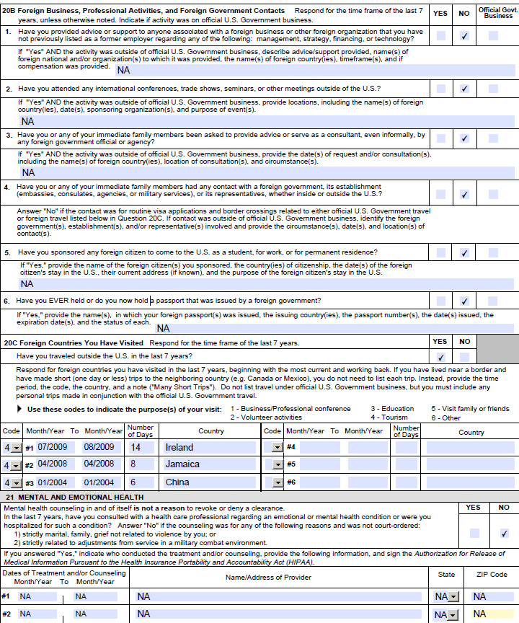

Slide 14
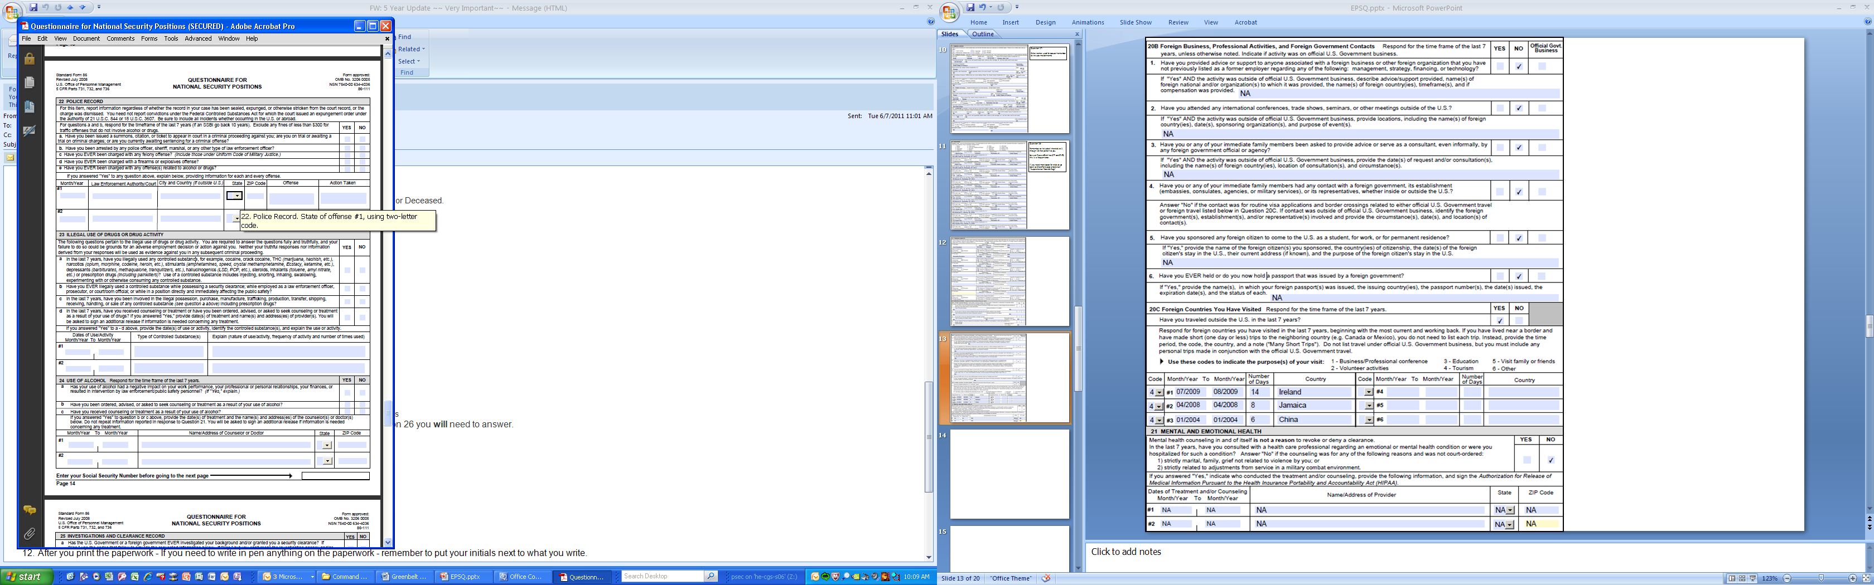

Slide 15
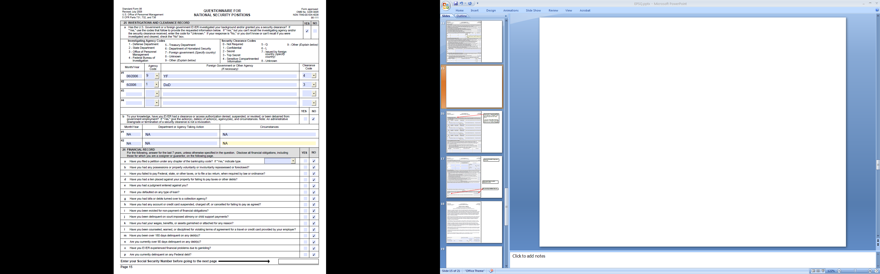
Question 25:
In your initial email that you 5-Year Update Paperwork is due you were given information to answer this question…please go back to email for further assistance.
For SCI:
Month and Year are required
Agency Code = 9
Foreign Gov./Other Agency = YF
Clearance Code = 4
For DoD:
Month and Year are required
Agency Code = 1
Foreign Gov./Other Agency = DoD
Clearance Code = 3

Slide 16
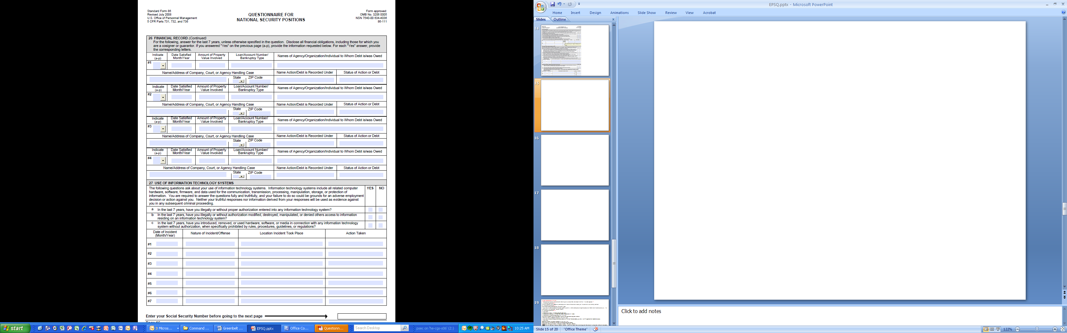
Question 26: If you answered “No” to every question – A through P…the 2nd part of the question 26 will be all N/A’s.
If you answered “YES” to one of the questions – A through P…you will need to answer the 2nd part of the question.

Slide 17
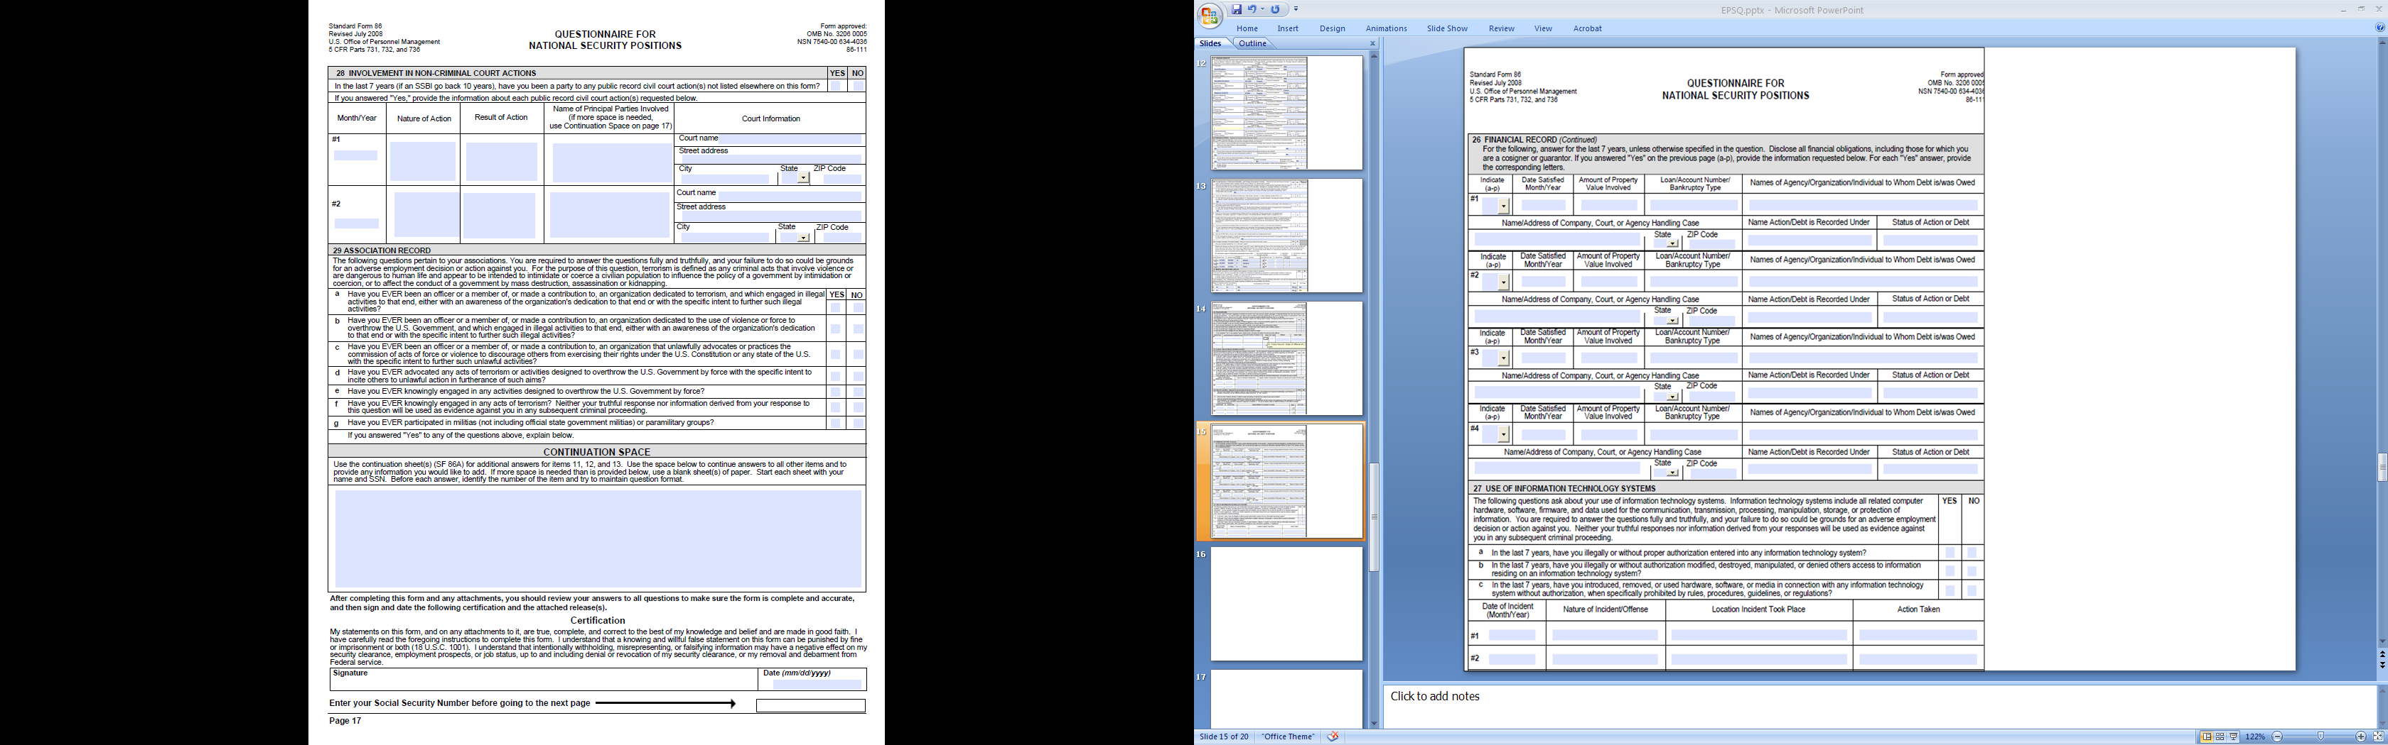
Question 28 and 29:
Simply answer yes or no.
Continuation Space is used for additional answers
Be sure to Sign and Date in Blue Ink.

Slide 18
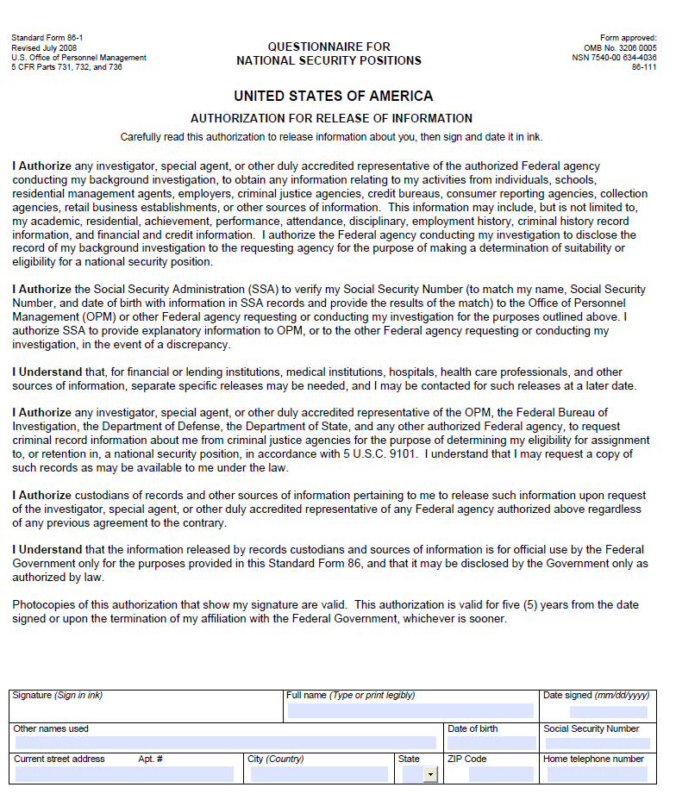
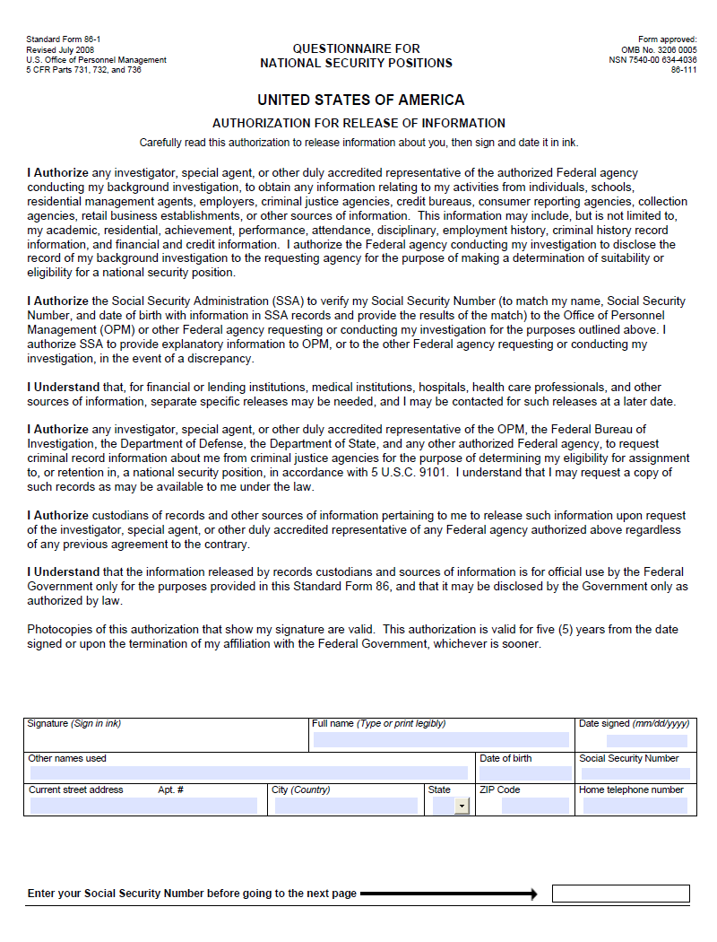
Complete the bottom portion and do not forget to sign in blue ink.

Slide 19
After you print the paperwork - If you need to write in pen anything on the paperwork - remember to put your initials next to what you write.
If you need help or have questions, please give Lynne Croft a call at 585-269-7400 or email her at lynne.croft@itt.com. Thank you and I hope this has been helpful.

