Slide 1
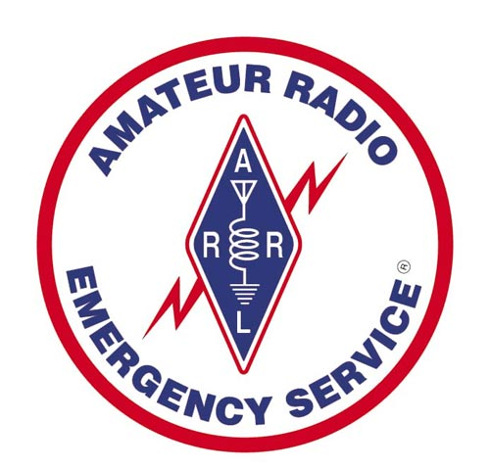

What Is Amateur Radio?
Why Is It a Community Resource?
Rural and Ready!
6th Annual Rural Preparedness Summit
June 6 and 7th, 2017
Presented by:
Bob Miller WA6MTY Emergency Coordinator
Washoe County Amateur Radio Emergency Service

Slide 2
Agenda
What Is Amateur Radio?
Why Is Amateur Radio a Community Resource?
How Can We Help?

Slide 3
What Is Amateur Radio?
Narrated by former CBS news anchorman Walter Cronkite, KB2GSD, “Amateur Radio Today” is a video which showcases the public service contributions made by hams throughout the country.
Narrated by former CBS news anchorman Walter Cronkite, KB2GSD, “Amateur Radio Today” is a video which showcases the public service contributions made by hams throughout the country.

Slide 4
What Is Amateur Radio?
The Federal Communications Commission definition of the Amateur Service is:
"A radio communication service for the purpose of self-training, intercommunication and technical investigations carried out by amateurs, that is, duly authorized persons interested in radio technique solely with a personal aim and without pecuniary interest.”

Slide 5
What Is Amateur Radio?
FCC Part 97.1 Basis and purpose.
(a) Recognition and enhancement of the value of the amateur service to the public as a voluntary, noncommercial communication service, particularly with respect to providing emergency communications.

Slide 6
What Is Amateur Radio?
Over 740,000 people from all walks of life have been licensed by the FCC, found in every corner of the US.
They use Amateur Radio as a hobby to contact other Amateur Radio operators halfway around the world or even across town!

Slide 7
Operation During a Disaster
FCC Part 97.401 (a) “When normal communication systems are overloaded, damaged or disrupted because a disaster has occurred, or is likely to occur in an area where the amateur service is regulated by the FCC, an amateur station may make transmissions necessary to meet essential communication needs and facilitate relief actions.”

Slide 8
Emergency Communications
What is an emergency?
  “…Planned or unplanned occurrence or event, regardless of cause, which requires action by emergency service personnel to prevent or minimize loss of life or damage to property and/or natural resources.”
What is a communications emergency?
  “...The result of…anything that disrupts normal communications.”
  “…When communications processes are inadequate to handle the flow required…”

Slide 9
Emergency Communications
How does ARES serve?
  Provide communications where the regular systems cannot.
  Provide additional and redundant communications
  Volunteer time and skills
  Provide the supporting equipment and infrastructure

Slide 10
Emergency Communications
What do we bring?
  A “service attitude”
  Knowledge, skill, experience, equipment
  Incident Command System Training
  Certification in Emergency Communications
  We are called amateurs because we cannot be paid therefore our service is FREE!!

Slide 11

American Red Cross
Shelter to Chapter Communications
Chapter to Headquarters Communications.
Health and Welfare Traffic
Thank you message KATRINA

Slide 12

Skywarn
SkyWarn is a National Weather Service (NWS) program of trained volunteer severe weather spotters.
SkyWarn volunteers support their local community by providing the NWS with timely and accurate significant weather reports.
The key focus of the SkyWarn program is to save lives and property through the use of the observations and reports of trained volunteers.

Slide 13
ARES Training
ARRL EMCOMM-1 Communications Training
This training includes the Incident
Command System:
  ICS100, ICS200, ICS700, ICS800

Slide 14
Just Where Have Hams Helped Out?
Tornados
Hurricanes
Floods
Earthquakes
Wildfires
Hams Assisted in Debris Search after Space Shuttle Explosion February 2003

Slide 15
Quotes from FEMA
Craig Fugate KK4INZ
FEMA ADMINISTRATOR
“Amateur Radio is often our last line of defense “
“When you need Amateur Radio, you really need them.”

Slide 16
Quote from The F.C.C.
Riley Hollingsworth
Former FCC Special Counsel for Amateur Radio Enforcement
"Amateur Radio is the only fail-safe communications service in the world“

Slide 17
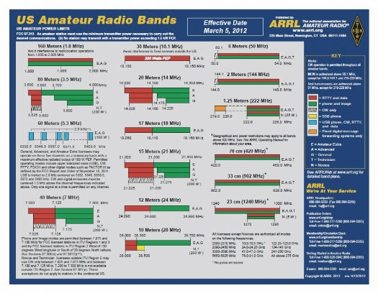
Why?

Slide 18
How?
CW-Morse Code
AM-Amplitude Modulation
FM-Frequency Modulation
SSB-Single Side Band
PACKET-Digital Communications
IRLP-Internet Radio Linking Project
ATV-Amateur Television Transmissions

Slide 19
How Can We Help?
During an EMERGENCY
  CELL PHONE Failure
  Landline Telephone Failure
  Local INTERNET Failure
Contact your Emergency Manager to request Amateur Radio Emergency Service.

Slide 20
Capabilities
NV Repeaters 499
North West NV Repeaters 209
  Includes Eastern California Repeaters

Slide 21
Nevada Hospitals
In 2008 the Director of Hospital
Preparedness obtained a grant to equip Nevada hospitals with backup Amateur
Radio Equipment.

Slide 22
NW District Hospital Communications Tests
The purpose of the Northwest Nevada Hospital weekly communicators net is to foster understanding and team work between the Hospitals and Medical Center staff that are amateur radio operators and Amateur Radio Emergency Service members (ARES).
To provide an opportunity for the staff and ARES members to become well acquainted with the radio equipment in their hospitals and medical centers.
The amateur radio rooms exist to provide emergency communications via amateur radio when regular communications systems are overloaded or fail

Slide 23
North West District Hospitals
Below are some of the Hospitals, and Medical Centers that are active, have radios as well as Ham Radio data systems, that check-in when they can.
  Incline Village Community Hospital
  Northern Nevada Medical Center
  Renown Regional Medical Center
  Renown South Meadows Medical Center
  Saint Mary's Regional Medical Center
  Washoe County Health District
  VA Sierra Nevada Health Care System
  Carson Tahoe Regional Medical Center
  Carson Valley Medical Center

Slide 24
North West District Hospitals
Below are some of the Hospitals, and Medical Centers that have radios, as well as Ham Radio data systems but are not active at this time.
  Renown Rehab Hospital
  West Hills Hospital
  Willow Springs Center
  Pershing General Hospital
  Banner Churchill Community Hospital
  South Lyon Medical Center

Slide 25
SENDING MESSAGES
Sending messages during a disaster
Voice communications
Packet Communications
Morse Code

Slide 26
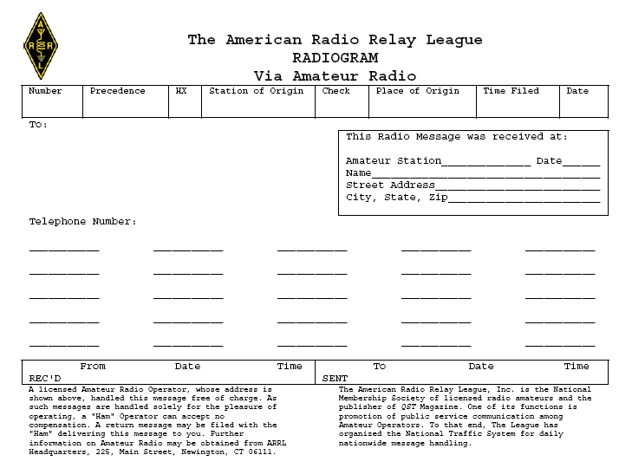
Radiogram

Slide 27
ITU Phonetic Alphabet
LTR
SPOKEN
PRONOUNCED
LTR
SPOKEN
PRONOUNCED
A
Alfa
AL FAH
N
November
NO VEM BER
B
Bravo
BRAH VOH
O
Oscar
OSS CAH
C
Charlie
CHAR LEE
P
Papa
PAH PAH
D
Delta
DELL TAH
Q
Quebec
KAY BECK
E
Echo
ECK OH
R
Romeo
ROW ME OH
F
Foxtrot
FOKS TROT
S
Sierra
SEE AIR RAH
G
Golf
GOLF
T
Tango
TANG GO
H
Hotel
HOH TELL
U
Uniform
YOU NEE FORM
I
India
IN DEE AH
V
Victor
VIK TOR
J
Juliet
JU LEE ETT
W
Whiskey
WISS KEY
K
Kilo
KEY LOH
X
X-ray
ECKS RAY
L
Lima
LEE MAH
Y
Yankee
YANG KEY
M
Mike
MIKE
Z
Zulu
ZOO LOO

Slide 28
Packet Communications
In 1978 Ham Radio Operators began experimenting with Packet Communications
A form of sending data messages by radio.
Essentially emails before anyone had access to the internet.

Slide 29
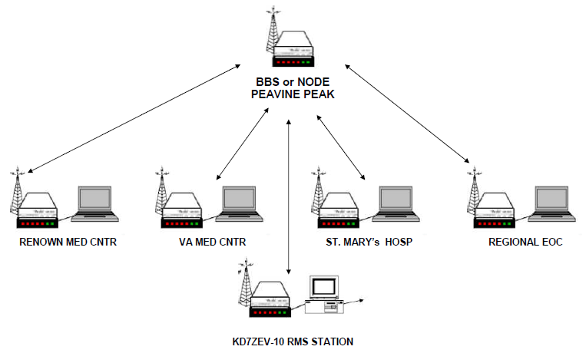
Northwest District Packet

Slide 30
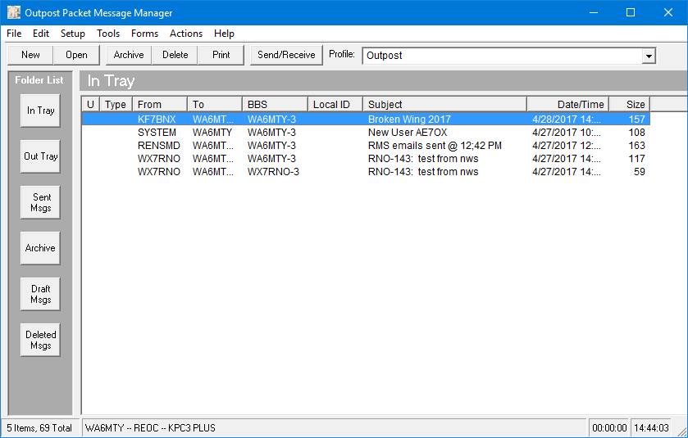
Outpost Packet Message Manager

Slide 31
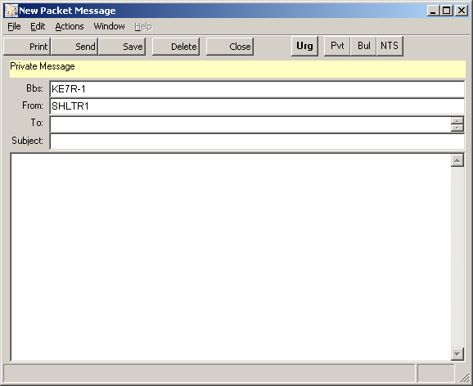
Outpost PMM

Slide 32
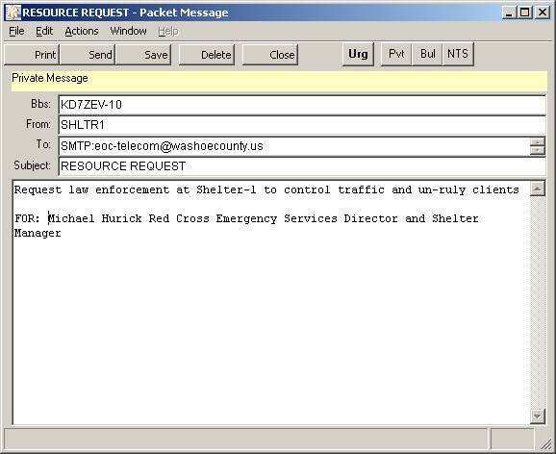
E-MAIL

Slide 33
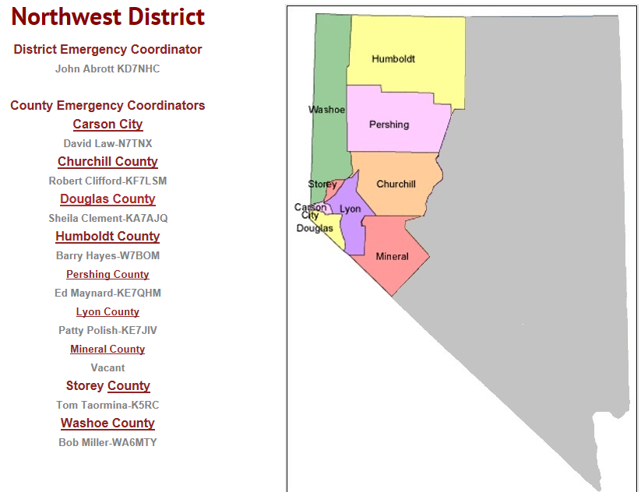
Northwest District

Slide 34
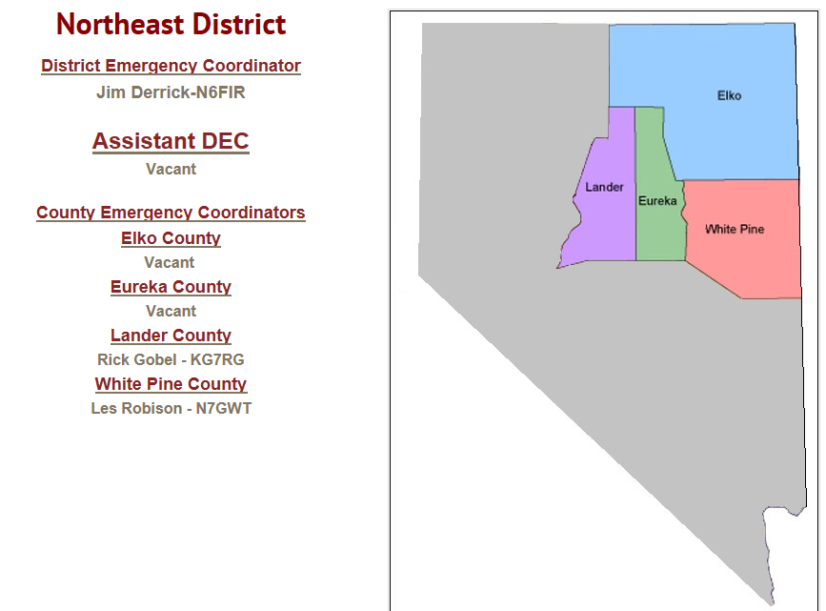
Northeast District

Slide 35
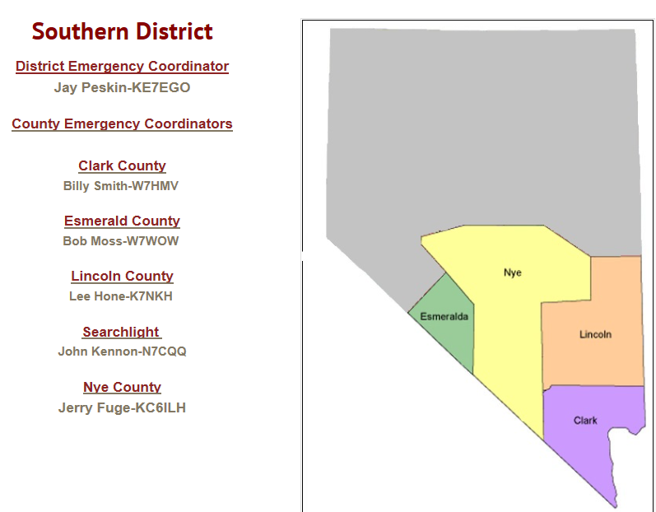
Southern District

Slide 36

Hospital AEC
Arlan Robinson KA7ZAU
Nevada State Hospital NET
  http://www.nvstatenet.webs.com/

Slide 37
Proud Associations:
Aaron Kenneston KE7GFF WC Emergency Manager
Charles Sharke KC7JKJ Pershing Cnty Emergency Manager
Chris Smith W4HMV Previous NV Chief Emergency Management
Craig Harrison KE6UOW WC Telecomm Manager (RETIRED)
Ed Atwell KB7UHM Emergency Manager UNR (RETIRED)
George Molnar KF2T Previous NV Interoperability Director
Kent Choma KF7EMU EM St. Mary’s Hospital
Rob McLaughlin KG7AAK Previous EM at VA Medical Center
Sandy Munns KG7BNZ EM City of Reno Fire Department (RETIRED)
Shawn Taylor N7LQ WC Senior Network Engineer

Slide 38
SUMMARY
Sending messages during a disaster
Voice communications
Morse Code
Packet Communications
Nevada Districts

Slide 39
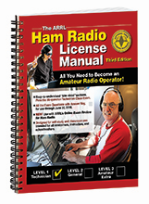
THE BOOK!

Slide 40
For More Information
www.wcares.us
www.Arrl-nevada.org
www.arrl.org
wa6mty@gbis.com

Slide 41
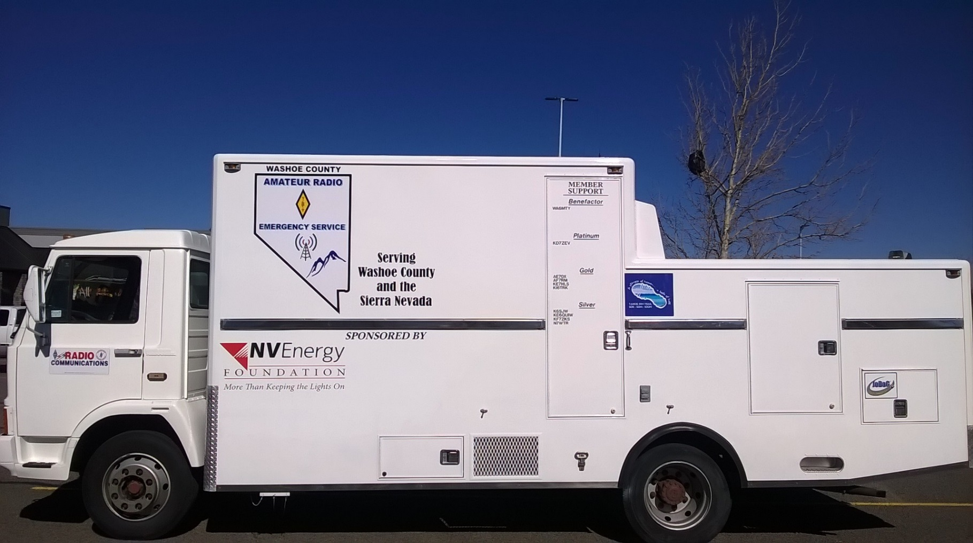
QUESTIONS?

