Slide 1
Test Readiness Review(TRR) and Software Item Qualification Test (SIQT)
Lunch and Learn
Instructor: Rose Osborne

Slide 2
TRR , SIQT and STR Objectives
Training Objective:
How to have a faultless Test Readiness Review(TRR) and satisfy Mil- STD- 1521B
How to have a smooth running Software Item Qualification Test (SIQT) – Lessons Learned
How to be 100% Compliance to the LM GPS III SDP by know the SIQT entry and exit criteria
.

Slide 3
Agenda
Definitions
Test Readiness Review (TRR) Preparation
Software Item Qualification Testing
Summary - SIQT Entry and Exit Criteria
Back Up Slides
Independence in Software Item Qualification Testing
Testing on the Target Computer System
Test Cases and Scripts Under Configuration
Required Input to enter Software Item Qualification Testing
Dry Run of Software Item Qualification Testing
Performing Software Item Qualification Testing
Analyzing and Recording Software Item Qualification Test Results – Master Software Test Procedure/ Description master Engineering Notebook
Plan on how and where to store test results and results analysis process Configuration
SIQT Exit Criteria
Revision and Retesting
DO 287 / 178B Compliance
The Software Test Report (STR)

Slide 4
TRR , SIQT and STR Definitions
Software Test Readiness Review (TRR) This is a review that is owned by the software organization. The objective of the review is to present and review the test plans and software readiness, including status of integration activities, to proceed with the formal acceptance testing
Software Item Qualification Test (SIQT) is validation phase where the product is ready to presently and formally test fully implemented software items and compare actual behavior to required behavior.
Software Acceptance Review -This is a review that is owned by the software organization. The objective of the review is to present and review the status of the software item qualification testing.
Software Test Report (STR) is a deliverable and a major milestone. This document the contains objective evidence of SIQT execution and it’s witnesses and approvals. Exelis will not be paid aware fee until STR is approved.
Testing on the Target Computer System - While the intent is the same, the terms are different for the GDAIS Software Process. SIQT is performed on flight hardware as required, but the hardware name is dependent upon the SI being tested. The end of phase review activity is the Software Formal Qualification Review (SW FQR), not the Software Acceptance Review.

Slide 5
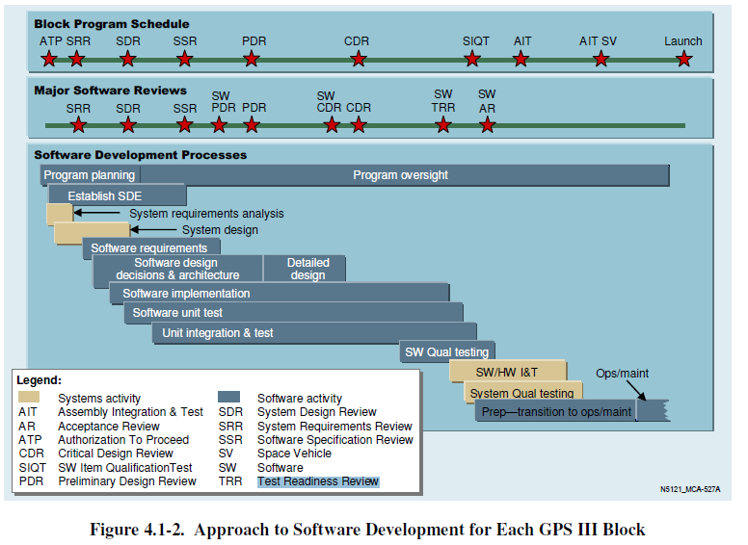
Software Development Process
TRR, SIQT after Successful Completion of SWIT

Slide 6
Test Readiness Review (TRR) Preparation:
A Test Readiness Review (TRR) Process and Input:
TRR Attendance Roster – Plan the list of individuals participating in and/or attending the TRR
On GPS III you need System Safety Engineer or System Engineer (SDP page 41); SQA, DCMA, LM Chief Technical Engineer, Aerospace Representatives, Software Independent Test, Test Conductor, TRR Package Presenter
Test overview – A description of the test events and the order which they will be performed, includes each test duration and verification method (DOORS Verification Attributes Method)
Sample Matrix
3. Test Unit or Unit Under Test Configuration – A description of the test item or units under test, including model, serial numbers for support HW Configuration and SW Version Descriptions.
Provide a matrix of test environment that includes hardware part number, serial numbers, Inputs, dB, test cases, test scripts, etc – Provide a detailed configuration matrix that has been verified to be accurate by Independent Group so no issues are found by SQA
4. Test Item or Unit Under Test Status – Provides information about the adequacy and readiness of the test item or Unit Under Test including: On GPS III Unit Under Test are either TSW or FSW.
Deltas from standard or mission configuration (STP)
Configurations management control status (Unit Under Test SCM Clear Case Label)
Test Procedure SWIT and Dry Run Status (Include a detail matrix, configurations used and outcome, redlines status SWIT and Dry run redlines have been incorporated and verified. Page 58 Dry Run2 Redline )
Reviews of open liens (DR History and Status) and/or operational constraints
Test limitations (some requirement may only be demonstrated by code inspection – need to match DOORs Verification Method attribute)

Slide 7
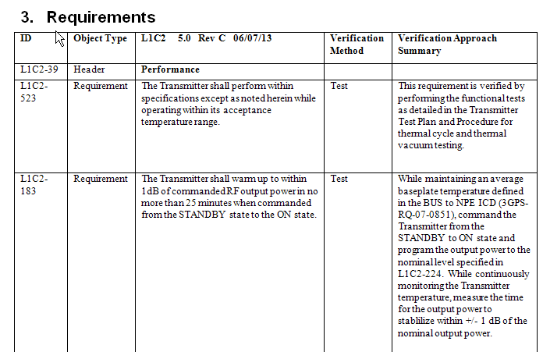
DOORs Sample

Slide 8
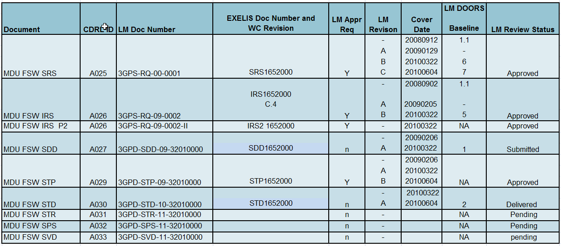
Test Readiness Review (TRR) Preparation:
5. Test Documentation Status – Status of each of the following types of documents:
Requirements documents (SRS, IRS, IRS part 2)
Verification Matrix (SRS to SDD to STP – Must be directional for FSW)
Test Plans
Test Descriptions – redlines from SWIT & Dry Run have been addressed. Page 58 Dry Run2 Redline
Database Products Required
Engineering changes (includes requirements and design changes)
Test Documentation Status – IMPORTANT INPUT REQUIREMENT FOR TRR: Documents must be approved by the Aerospace, LM and by Exelis ( Released and Approved in Winchell (not issued) by TRR date. Exelis needs to send SDRLs for LM SCCB approval IAW the SDRL lists usually 30 days prior to TRR
Software FSW CDRLs

Slide 9
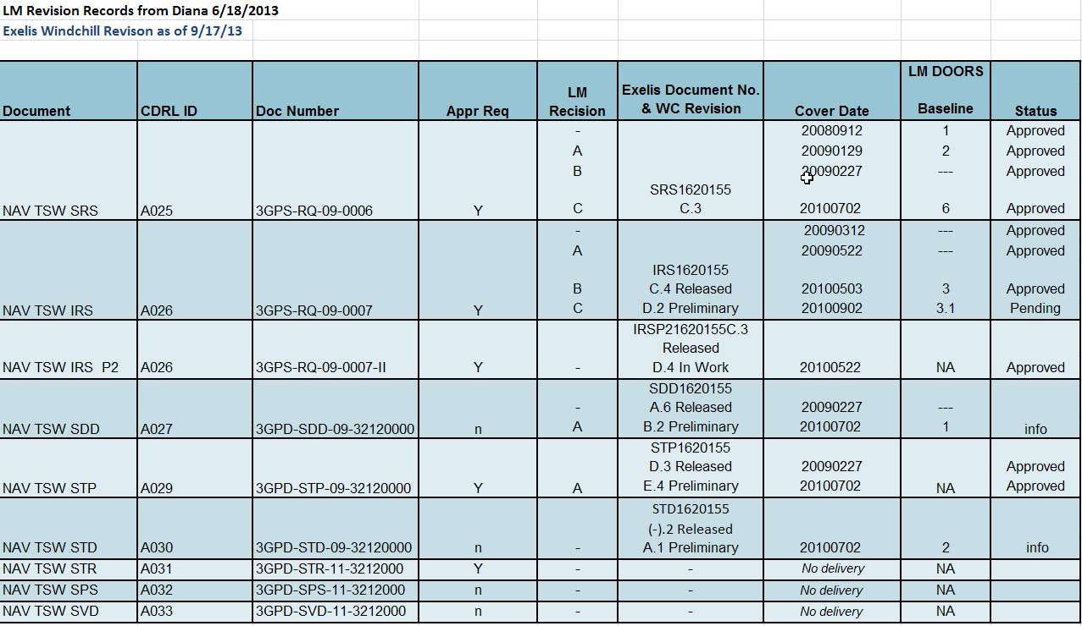
Documentation Configuration

Slide 10
Test Readiness Review (TRR) Preparation:
Test Software Status – Provide information about the adequacy and readiness of test software, Scripts or data processing tools
Matrix listing test software, software tools, Inputs, dB, test cases, test scripts, etc – Provide a detailed configuration matrix that has been verified to be accurate by Independent Group so no issues are found by SQA
7. Test Facilities Status – That portion of the TRR presentation that provides information about the adequacy and readiness of test facilities; hardware and STE/COTS STE Calibration Status, hardware sealed by QA.
Test Personnel Status – Provides information about the adequacy and readiness of test personnel
Required skills
Additional training needed
Certifications required (including Certified Test Conductor, if necessary)
Require security
Who will be conducting the test, collecting results, SQA
Test Safety – That portion of the TRR presentation that provides information about the adequacy of mitigation of potential hazards to personnel, products, equipment, and facilities including System Safety Engineering
Test Schedule – Provides information about the test start date, duration, and shifts and time for data and test results evaluation. Plan Software Acceptance Review

Slide 11
Test Readiness Review (TRR) Preparation:
11. TRR Action Item List Status – Provide the status and description of any open action items that pertain to this test event.
Approval-to-Proceed Form – An OK-to-Proceed statement form with concurrence signatures from Program Management, Quality Engineering, SW Test Engineer, Test Conductor and the Customer (As appropriate) – this approval needs to be asked and documented in the TRR meeting minutes.

Slide 12
Test Readiness Review (TRR) Inputs:
Summary
CDRLs/SDRLs SVD approved and released. SQA has witnessed build and installation IAW SVD.
All SI (CSCIs), Test Scripts, Test Cases, Test Input Data are to be under Software Configuration Controls and in Windchill before start TRR. Test Tools configuration are to be verified. SCM Record to be presented at TRR.
Matrix of Configuration of UUT (TSW or FSW SI) and all equipment/hardware to be used at SIQT typed and final verified by SQA prior to TRR. Have test setup sealed by QA; Hardware may not be modified during SIQT. Gate Test Area,
All STE and COTS STE equipments needs to be with in calibration (make sure will not expire during the SIQT timeframe)
Master Software Test Plan and Software Test Procedure/Description Binder; make sure you have proper markings, page number, single sided, correct binder size.
6. SWIT and Dry run redlines are verified. During SIQT Document any redlines must be done neatly in Master Test Procedure/Description; Only use black pen for sign off.
7. Witness sign after each test, do not start a new test until the Previous test datasheet and hard copy results are signed off (Aerospace, LM, SQA)

Slide 13
Test Readiness Review (TRR) Artifact samples
11 TRR Checklist
TRR Checklist _ May 14th 2013
TRR Attendance Sheet-4-2-13
TRR Attendance May 14th
XMTR STE SW TRR 2013 05 14
XMTRSTE ATP SW DR Matrix with Testing and Documentation Info
TRR_OutBrief_Attendance_List because I did not know this was done, I did
not have a attendance form – so be prepare ☺

Slide 14
Software Item Qualification Test (SIQT) Process
Source NAVSTAR GLOBAL POSITIONING SYSTEM (GPS) III Phase B
Software Development Plan , Document No. 3GPS-PN Revision H 19 Dec 2011
5.9 Software Item Qualification Testing
5.9.1 Independence in Software Item Qualification Testing
5.9.2 Testing on the Target Computer System
5.9.3 Preparing for Software Item Qualification Testing
5.9.4 Dry Run of Software Item Qualification Testing
5.9.5 Performing Software Item Qualification Testing
5.9.6 Revision and Retesting
5.9.7 Analyzing and Recording Software Item Qualification Test Results

Slide 15
Software Item Qualification Test (SIQT) Process
The purpose of the Software Item Qualification Testing phase is to formally test the fully implemented software items and compare actual behavior to required behavior.
Software related problems are captured in a discrepancy report –
Exelis goal is to encounter zero(0) defects and NO redlines. These should be addressed during SWIT and Dry Run.
Defects resulting in failure of flight software observed during SIQT or later will be entered into the LM FRACAS database.
Prior to this point, software is in development and not subject to FRACAS reporting requirements. Only the eternal in ClearQuest® DR tracking database.
The LM FRACAS database will not be populated for failures of non-flight software nor will it
be populated for software failures prior to SIQT. All anomalies observed during these phases
will be documented in ClearQuest®
For software failures identified during SIQT, the notification requirement will be satisfied through GPSD (Customer) real-time participation. They witness the SIQT.
Subsequent to SIQT and prior to Space Vehicle (SV) Assembly, Integration and Test (AI&T), software failures will be reported to the GPSD (Customer) or its designated
representative within one week of occurrence.
Note: SV AI&T failures, Lockheed Martin will notify the GPSD or its designated representative within one working day.

Slide 16
Software Item Qualification Test (SIQT) Process
This activity will apply to both development and maintenance, although for maintenance testing is only a subset of the tests used for development are required to be run. This subset will be defined before the software transitions into maintenance mode, and will become the regression test suite that will be run against each maintenance build (new SIRNs). The customer is invited to participate in the definition of the regression test suite.
Verification entry criteria are approved at the SIQT TRR:
SIQT Test Plans and Test Procedures / Test Descriptions
Peer Reviews of all SIQT Test Plans and SIQT Test Procedures are complete and signed off by the Verification and Validation team, and the respective Lockheed Martin SI CPE
SCCB approval of SIQT Test Plan and SIQT Procedure
Approved by Aerospace, LM, and Exelis*(Windchill Approval)
Peer Review Closed
The SIQT test environment has been approved via the SCCB and Lockheed Martin SI CPE (document in matrix and verify accuracy – > goes in the Software Test Report STR)

Slide 17
Software Item Qualification Test (SIQT) Process
Each of the units is complete, tested, and under SCM control via the SCCB (LM and Exelis)
Verification Phase exit criteria is approved upon the following criteria successfully completed and signed off by each of the teammate’s respective IPT’s software lead and the respective Lockheed martin SI CPE(Chief Project Engineer) :
Verification Test Procedures/Test Descriptions have been successfully executed with
the following items closed:
Each Verification Test Procedure step has been executed with the correct results, verified by the tester, and reviewed and approved by the Verification and Validation team, Lockheed Martin SI CPE and SQA (LM & Exelis).
Test Results for each Test Procedure have undergone a Peer Review and are approved by the Lockheed Martin SI CPE and SQA (LM & Exelis). Complete prior to TRR.
All defects of severity levels 1, 2 and 3 have been signed off by the customer.

Slide 18
Independence in SW Item Qualification Testing
Software item tests are conducted in accordance with procedures documented in the Software Test Description (STD) for each software item.
The developer performs a “dry run” of the software item qualification test prior to running SIQT tests.
Independence in software item qualification testing does not preclude persons who performed detailed design or implementation of the software item from contributing to the process, for example, by contributing test cases that rely on knowledge of the software item’s internal implementation.
NOTE: Although a developer who wrote design or code for a particular function is allowed to write the test case, the same developer is not allowed to verify/sign off on the test results.
On GPS III we have Hamida Yaniero, Julie Fazio, Bill Wong, Willie Guan independently conducting the SIQT SWIT to ensure readiness for the formal SIQT.
All flight software items which are resident on the GPSIII space vehicle (s) are qualified at the respective teammate’s facility with dedicated testing resources.
The GPS III NPE Test Software is also formally validated via a SIQT prior to the Flight Software SIQT.

Slide 19
SIQT Artifact samples
XMTR STE SW Post dSIQT Review 2013 05 14
Take Attendance and document if SIQT was accepted by team.
Sample XMTR STE TSW dSIQP Final STAR (Test Report):
XMTR July 3 2013 SCCB
XMTR STE TSW dSIQP Final STAR (Test Report)

Slide 20
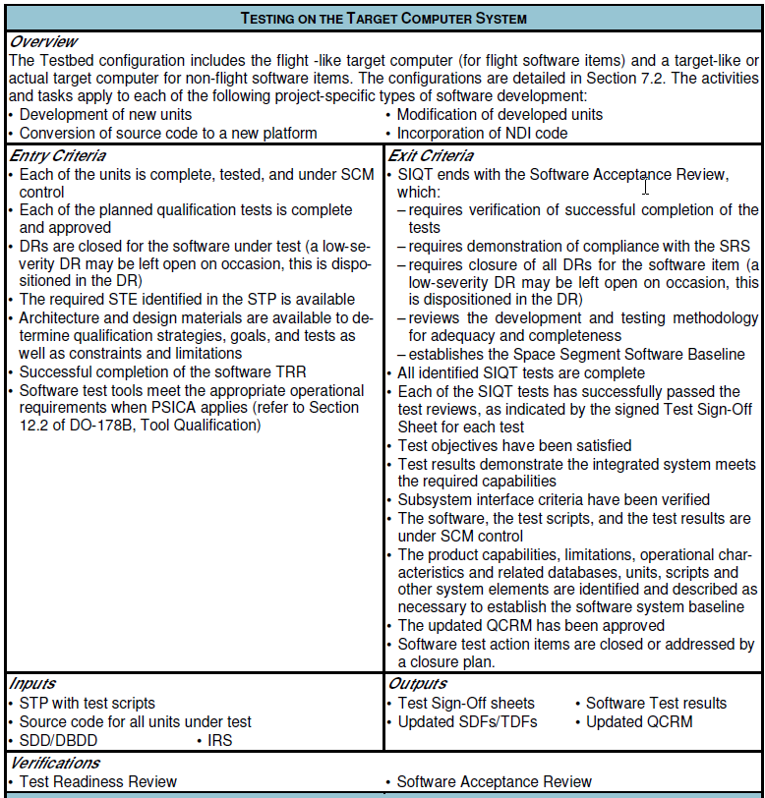
Summary - SIQT Entry and Exit Criteria
Testing on the Target Computer System SDP Section 5.9.2

Slide 21
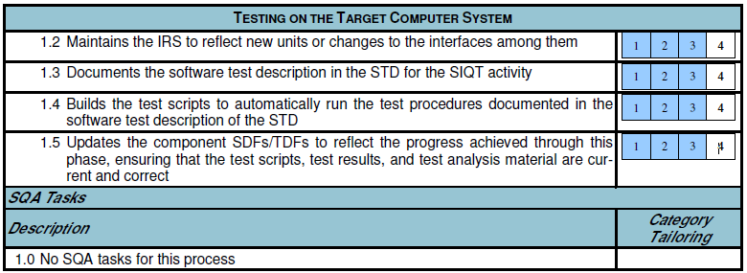
Summary - SIQT Entry and Exit Criteria
Testing on the Target Computer System SDP Section 5.9.2

Slide 22
Back Up Slides
TRR SIQT Training Presentation_RO

Slide 23
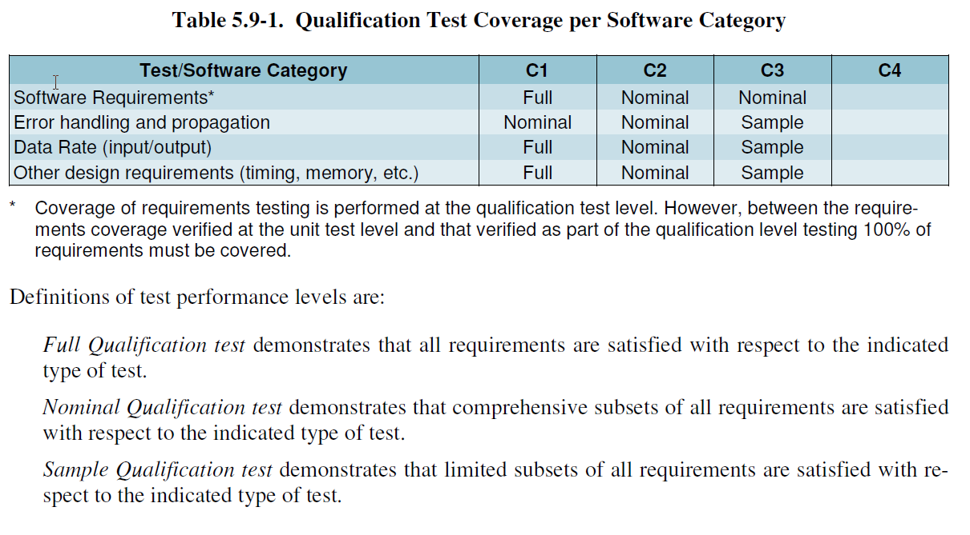
Preparing for Software Item Qualification Testing SDP Section 5.9.3
Appropriate tests are indicated for each software category in Table 5.9-1. Tests to be performed are defined by the SDT and approved by the Software Development Lead.
Verification Phase exit criteria is approved upon the following criteria successfully completed and signed off by each of the teammate’s respective IPT’s software lead and the respective Lockheed martin SI CPE(Chief Project Engineer) :
Verification Test Procedures/Test Descriptions have been successfully executed with
the following items closed:

Slide 24
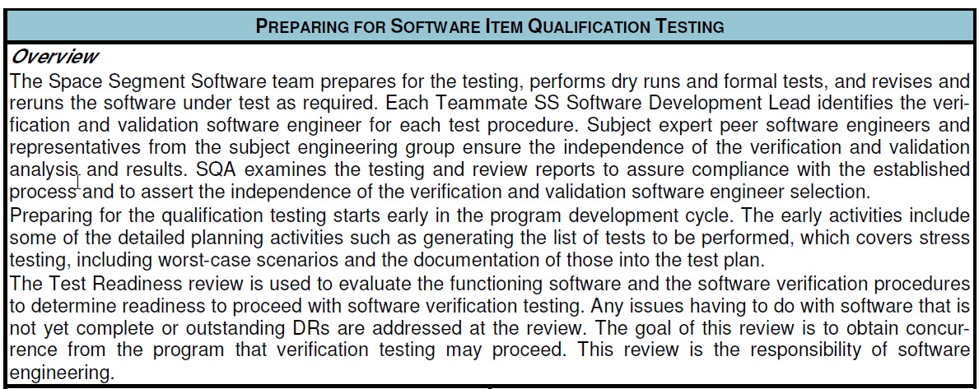
Preparing for Software Item Qualification Testing SDP Section 5.9.3

Slide 25
Preparing for Software Item Qualification Testing SDP Section 5.9.3

Slide 26
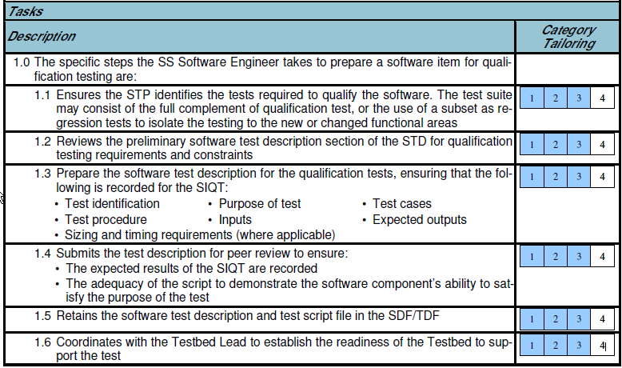
Preparing for Software Item Qualification Testing SDP Section 5.9.3

Slide 27
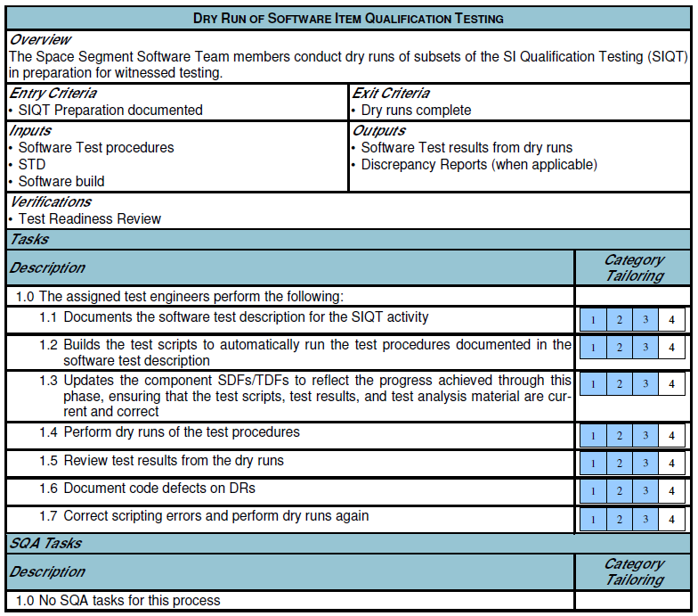
Dry Run of Software Item Qualification Testing SDP Section 5.9.4

Slide 28
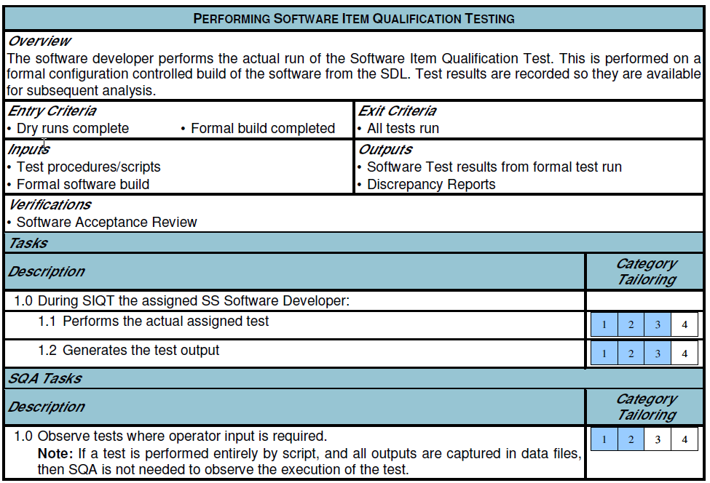
Performing the Software Item Qualification Testing SDP Section 5.9.5

Slide 29
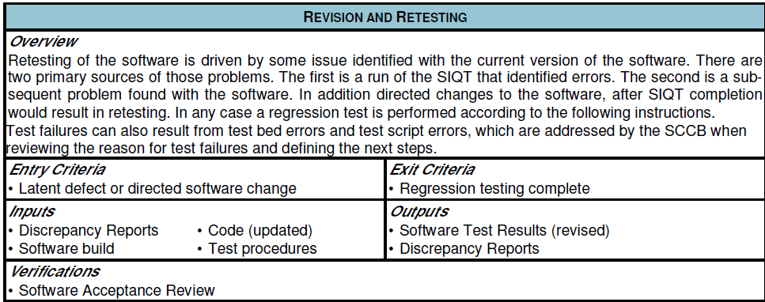
Delta SIQT – New Revision and Retesting SDP Section 5.9.6

Slide 30
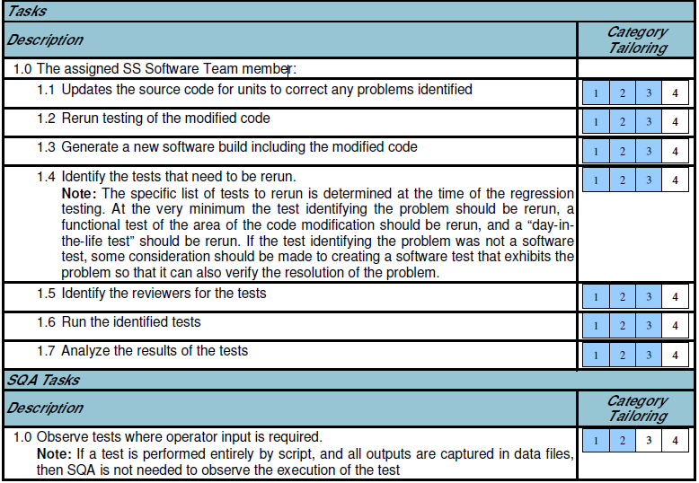
Delta SIQT – New Revision and Retesting SDP Section 5.9.6

Slide 31
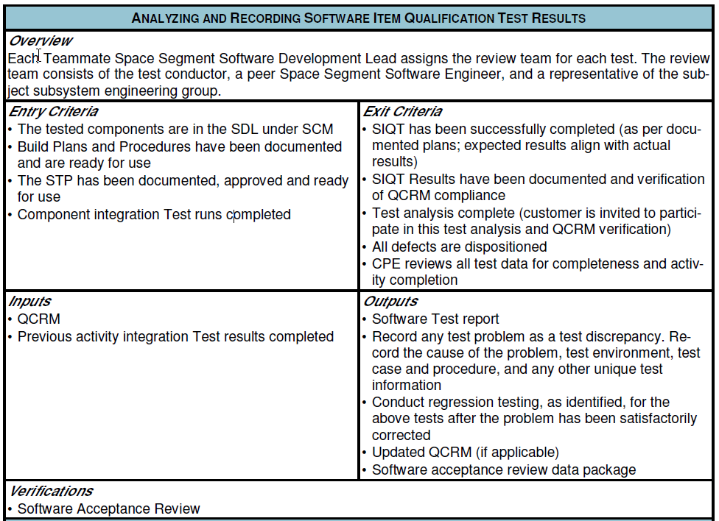
Analyzing and Recording Software Item Qualification Test Results SDP Section 5.9.7

Slide 32
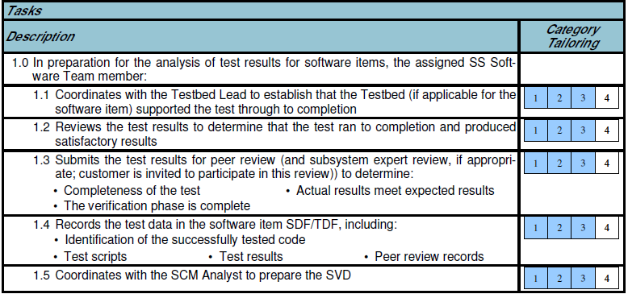
Analyzing and Recording Software Item Qualification Test Results SDP Section 5.9.7

Slide 33
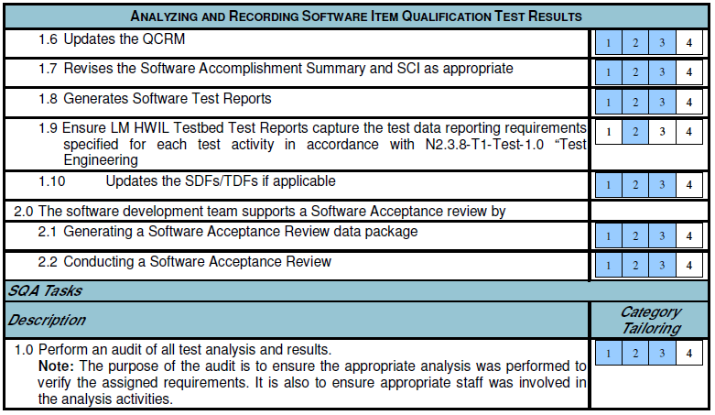
Analyzing and Recording Software Item Qualification Test Results SDP Section 5.9.7

Slide 34
Analyzing and Recording Software Item Qualification Test Results SDP Section 5.9.7

Slide 35
Analyzing and Recording Software Item Qualification Test Results SDP Section 5.9.7

Slide 36
Links
SDP 3GPS-PN-07-0101 SDP Rev H 121911
MIL-STD-1521B/T Notice 2 Military Standard Technical Reviews & Audits for Systems,
Equipments, and Computer Software (Tailored for GPS III)
Technical Library 3 And SOW_1521B_tailoring
LM TRR Checklist 11 TRR Checklist
SDRLs TSW Documents - Latest on WGC as of July 31 2013 - Work in Progress
Document Configuration - Work in Progress
Test Procedure Dry Run Status (Include a detail matrix) TSW_SIQT_PracticeDryRun_Testcase_Execution_Status_ByMinutes

Slide 37
DO-178B Software Safety Levels
DO-178B Software Safety Levels Review

Slide 38
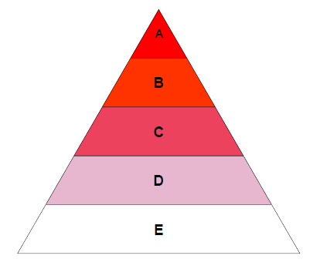
DO-178B Software Safety Levels
The Design Assurance Level (DAL) is determined from the safety assessment process and hazard analysis by examining the effects of a failure condition in the system. The failure conditions are categorized by their effects on the aircraft, crew, and passengers.
Software Safety Levels A-E
Catastrophic - Failure may cause a crash. Error or loss of critical function required to safely fly and land aircraft.
Hazardous - Failure has a large negative impact on safety or performance, or reduces the ability of the crew to operate the aircraft due to physical distress or a higher workload, or causes serious or fatal injuries among the passengers. (Safety-significant)
Major - Failure is significant, but has a lesser impact than a Hazardous failure (for example, leads to passenger discomfort rather than injuries)or significantly increases crew workload (safety related)
Minor - Failure is noticeable, but has a lesser impact than a Major failure (for example, causing passenger inconvenience or a routine flight plan change)
No Effect - Failure has no impact on safety, aircraft operation, or crew workload.

Slide 39
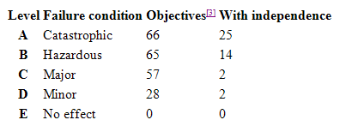
DO-178B Software Safety Levels
The number of objectives to be satisfied (eventually with independence) is determined by the software safety level A-E. The phrase "with independence" refers to a separation of responsibilities where the objectivity of the verification and validation processes is ensured by virtue of their "independence" from the software development team. In some cases, an automated tool may be equivalent to independence. For example, on GPS III all Unit test were performed by Test engineers in ROC or FW, but all the development was in NJ.

Slide 40
DO-278 Software Assurance Levels Definitions
Assurance Level:
Assurance Level 1 (AL1) – Software whose anomalous behavior, as shown by the system safety assessment process, would cause or contribute to a failure of system function resulting in catastrophic failure condition for the GPS mission.
Assurance Level 2 (AL2) – Software whose anomalous behavior, as shown by the system safety assessment process, would cause or contribute to a failure of system function resulting in a hazardous/severe-major failure condition for the GPS mission.
Assurance Level 3 (AL3) – Software whose anomalous behavior, as shown by the system safety assessment process, would cause or contribute to a failure of system function resulting in a major failure condition for OCX resulting in a moderate probability of minor impact to the GPS mission.
Assurance Level 4 (AL4) – Software whose anomalous behavior, as shown by the system safety assessment process, would cause or contribute to a failure of system function resulting in a moderate failure condition for OCX resulting in a low probability of minor impact to the GPS mission.
Assurance Level 5 (AL5) – Software whose anomalous behavior, as shown by the system safety assessment process, would cause or contribute to a failure of system function resulting in a minor failure condition for OCX resulting in no impact to the GPS mission.
Assurance Level 6 (AL6) – Software whose anomalous behavior, as shown by a safety assessment process, cannot cause or contribute to a failure of system function with a safety impact.

Slide 41
Relationship of Safety Levels and Assurance Levels
Software Assurance Levels
The results of a safety assessment process is used to establish the appropriate software assurance level for all elements of the CNS/ATM system. Software Assurance Levels refer to the “assigned” Safety Level.
GPS III
OCX

Slide 42
Exelis New Jersey GS Projects
The GPS III NAV payload software, Flight Software, is being designed and developed by Exelis. This software module has been assigned a Development Assurance Level (DAL) of 3.
The GPS OCX ground software module have been assigned a Development Assurance Level (DAL) of 4.
DAL 4 applies to NAV, KEM, SIM and MUG.
Note: The hardware/firmware aspects of the GPS III and OCX Program (OMSRE and KEM) fall under DO-254 (Design Assurance Guidance for Airborne Electronic Hardware) and are not covered in this training.

Slide 43
Exelis Software CIs and Components
Note: The information above is extracted from historical program documentation. “Block IIIA” for GPS III is now designated SV01 (Space Vehicle 1) and the Integrity Monitor functionality is currently on hold indefinitely. “All other CIs (ITT)” indicates all Exelis OCX software work done for NAV, KEM, MUG, and SIM.

Slide 44
DO-178B: Testing of Outputs of Integration Process

Slide 45
DO-178B: Verification of Verification Process Results

Slide 46
DO-178B: Configuration Management Process

Slide 47
DO-178B: Software Quality Assurance

