Slide 1

Raspberry Pi Products & Accessories
BotnLife - Online Thailand Shop for Wearable Hi-tech Electronics Devices & Raspberry Pi Products

Slide 2
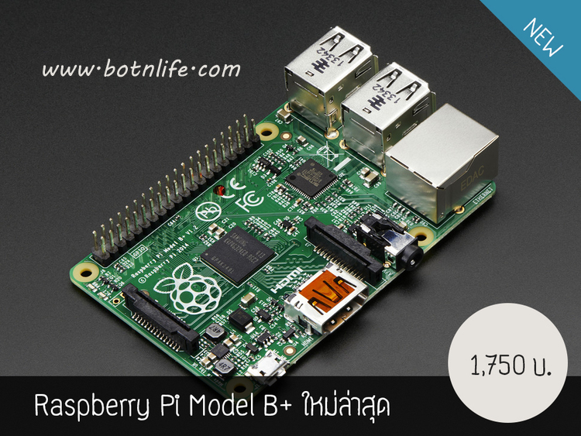
Raspberry Pi Model B + 512MB RAM

Slide 3
Raspberry Pi Model B + 512MB RAM
Raspberry Pi Raspberry Pie-board computer was developed in England to build a learning computer. Designed by Broadcom BCM 2 835 System on a Chip (SoC) processors, ARM 1176th JZF-S 700 MHz, VideoCore IV GPU, and memory size. 512 MB ​​paddle designed without memory. (Hard disk drive or solid-state drives), but rely on the SD card to boot and to a storage unit.
Raspberry Pi Model B + upgrade from the original. The port USB rise ,increasing pin GPIO, improve the capacity to better , more holes drilled four holes for assembly and numerous other teams called raspberry pie, take suggestions. Collected over three years to develop the model B +this. And the same price!

Slide 4
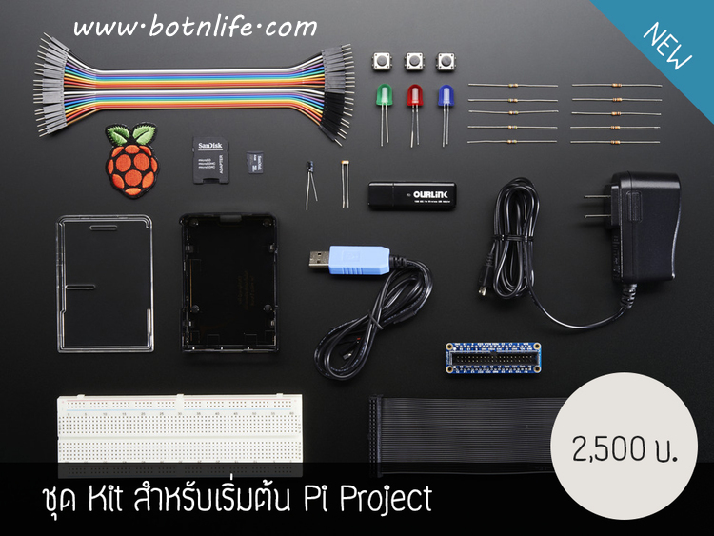
Raspberry Pi Model B+ Starter Pack

Slide 5
Raspberry Pi Model B+ Starter Pack
You are about to start a project out of the rowing course you have to solder, without programming. They must also wear a heart inventor and much more, we need to start your first step is very simple. We collect the devices that we think is best for a beginner kit is easy to use.
This unit will gather important such as the power unit, Raspbian SD card, Case, WiFi adapter, console cable, and other components for the initial prototype for this is the crucial point that you begin to jump.
Accessories are not included in the Raspberry Pie B +!

Slide 6
Interesting, right?
This is just a sneak preview of the full presentation. We hope you like it! To see the rest of it, just click here to view it in full on PowerShow.com. Then, if you’d like, you can also log in to PowerShow.com to download the entire presentation for free.

