Slide 1

Get Started with Raspberry Pi- Single Board Computer

Slide 2

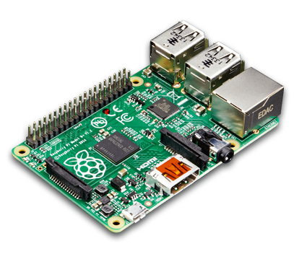
Raspberry pi is a very small computer which is very useful in DIY projects. For $35, You can get model A or B with HDMI and composite Video output. A big news is that raspberry pi zero is released for just $5. You can add up more USB devices. You can make your own VPN server with the raspberry pi.

Slide 3
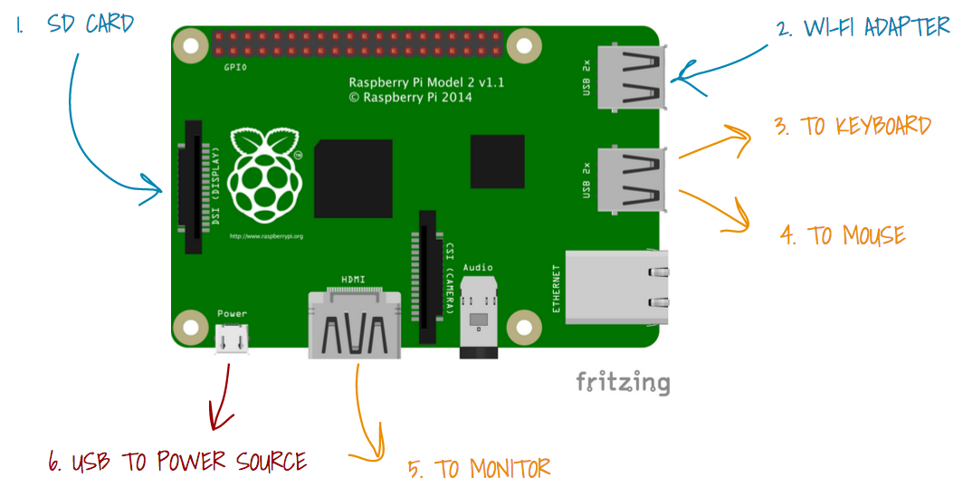
Block diagram of Raspberry Pi Model

Slide 4
Interesting, right?
This is just a sneak preview of the full presentation. We hope you like it! To see the rest of it, just click here to view it in full on PowerShow.com. Then, if you’d like, you can also log in to PowerShow.com to download the entire presentation for free.

